Slide 1
Healthcare Workplace Violence Recognition and Prevention
Presented By:
Steve Wilder, BA, CHSP, STS
Sorensen, Wilder & Associates
Bourbonnais, IL

Slide 2
THE NEW AND THE OLD
Always been here…
  ED aggression
  Behavioral health aggression
  Disconnects between regulatory agencies
  Many more…
New challenges on the block…
  Armed intruder / concealed weapons
  Active shooter
  Synthetic recreational drugs
  OSHA involvement

Slide 3


Hospital for Special Care
February 22, 2012
New Britain, CT

Slide 4
Case Study:
Hospital for Special Care
New Britain, CT
Facility Overview
205 Long Term Acute Care beds on this campus
  100 to 110 ventilator dependent patients
  Remaining are Rehab and Traumatic Brain Injury
100 to 150 employees on 2nd shift (when incident occurred)
29 access points into the facility
Security Staffing: Two (2) security personnel (all shifts)

Slide 5
Case Study:
Hospital for Special Care
New Britain, CT
On February 22, 2012 at approximately 1750 hours, the Hospital for Special Care in New Britain, CT experienced an act of violence that significantly disrupted facility operations.

Slide 6
Case Study:
Hospital for Special Care New Britain, CT
Incident Overview
A shooter enters the facility via employee entrance
Shooter passes nurse who is heading towards the elevator in hallway of basement; says nothing to her
While waiting for elevator, nurse hears 4 gunshots and someone shouts: “Oh My God…”
Nurse calls the facility switchboard
Security responds to incident location
Shooter is gone upon arrival of security

Slide 7
Case Study:
Hospital for Special Care New Britain, CT
SECURITY RESPONSE
Security locates two (2) victims
• Requests a ‘Dr. Quick’ (Rapid Clinical Response Team)
Incident identified and labeled as a ‘SHOOTING’: switchboard follows up by announcing a ‘Dr. Safe’ (Security Event: Defend-in-Place / Lockdown)
Switchboard operator calls 911
Reportedly, there were seven (7) 911 calls
‘Dr. Safe’ protocols implemented throughout the facility
Notes:
Play 911 call after bullet point “Reportedly, there were seven (7) 911 calls”

Slide 8
Case Study:
Hospital for Special CareNew Britain, CT
Police Actions Upon Arrival
Police secure the basement and lower level
Police ask switchboard operator to evacuate the hospital - she refuses
Security direct the police to area of shooting
Police provided cover for the responders and assists with victim evacuation
Secured the crime scene
Continued search of lower level for shooter

Slide 9
Case Study:
Hospital for Special Care New Britain, CT
Special Weapons and Tactics (SWAT) Team
Emergency Response Team (ERT)
SWAT / ERT arrive from surrounding towns and state
Secure entire building - Lockdown
Secure city block
Respond to additional facility-owned building (secure location)

Slide 10
Case Study:
Hospital for Special Care-New Britain, CT
AT THE SCENE
EMS prepares for a full building evacuation (all patients)
Police request building blueprints, keys and a photo of the shooter(s)
  Reports indicated there may have been 2 shooters
  Would not allow access to obtain these items
Incident Command was fragmented and unorganized
Communication was challenged
  Phone lines were congested by families and staff calling the facility
  Media quickly broadcasted the incident; heavy Facebook and Twitter activity (people on scene)

Slide 11
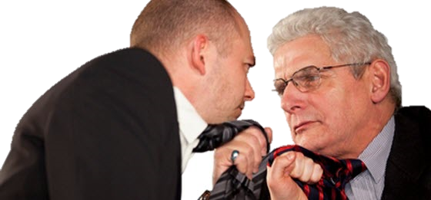

Case Study:
Hospital for Special CareNew Britain, CT
Focus and Goals Divided
Police
Hospital Administration
Assure patient safety
Return staff back to work
Not ready for police evacuation order of the facility including patients and staff
Operate ‘as normal’
Assure everyone's safety
Continued ‘Lock Down’ until facility was tactically cleared from all threats
Crime scene preservation

Slide 12
Case Study:
Hospital for Special Care New Britain, CT
LOCKDOWN: Unforeseen Issues
Code team was escorted out of building – not allowed to return
2nd Shift – Massive impact to continuity of care (large code
team)
Other staff not on clinical unit – could not return
Do not expect that you will be able to go back to work…are you and the staff: Victims, Witnesses, Mental Trauma/stress, Next Target
All hospital leadership thought to be possible targets; They were isolated and not allowed to leave police protection!

Slide 13
Case Study:
Hospital for Special Care-New Britain, CT
Police Response: Unexpected Issues
Police response: Enormous!
  Patrol cars
  SWAT armored vehicle
  Helicopter
  Mobile Command
Campus access– so congested with police vehicles that the ambulances transporting the victims had difficulty leaving the facility

Slide 14
Case Study:
Hospital for Special Care-New Britain, CT
Immediate Steps Taken
Communications:
  Heads of Nursing, Facilities and Quality established cell phone communications with charge nurses
Established a plan with Police on scene to escort a response team - medical emergency
Public Information Officer (PIO) established communication at satellite location

Slide 15
Case Study:
Hospital for Special Care-New Britain, CT
Clearing the facility
Police cleared and secured one unit at a time
Every door, chase, cabinet, etc. was opened and checked
As they cleared each unit, they posted security at each end and allowed staff to come back in
Traumatic Brain Injury (TBI) Unit situation

Slide 16
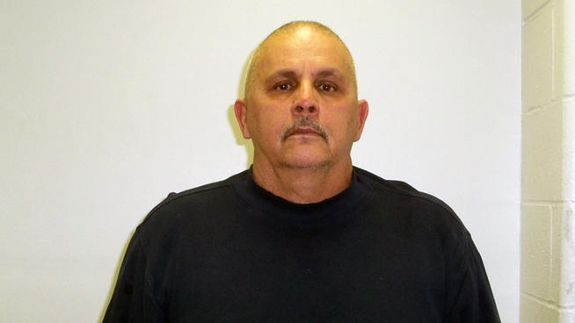
Case Study:
Hospital for Special Care-New Britain, CT
Victor Valcarcel Sr. 65, a building services aide at the hospital, was disciplined and sent home. He returned soon after and shot his two supervisors

Slide 17
Today I was so mad, I was crazy and I wanted to kill Bob and Lynn, so I took the gun from under the floor board in the attic ... I told my wife that I was going back to work to get my things…
Victor Valcarcel Sr. statement to the police after being arrested for the shooting of Lynn Trask and Robert Barucci at Hospital for Special Care, New Britain, CT
Motive

Slide 18
It happened so quick, I shot four times … I think they cried out, “Oh My God.” They fell to the ground. I think I shot Lynn once, then Bob once, then Lynn one more time and then Bob, like back and forth and back again…
Victor Valcarcel Sr. statement to the police after being arrested for the shooting of Lynn Trask and Robert Barucci at Hospital for Special Care, New Britain, CT
Motive

Slide 19
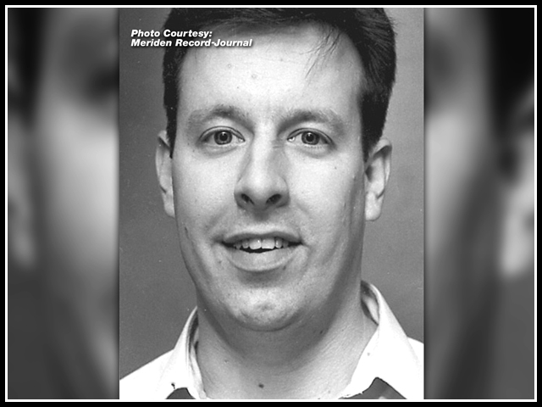
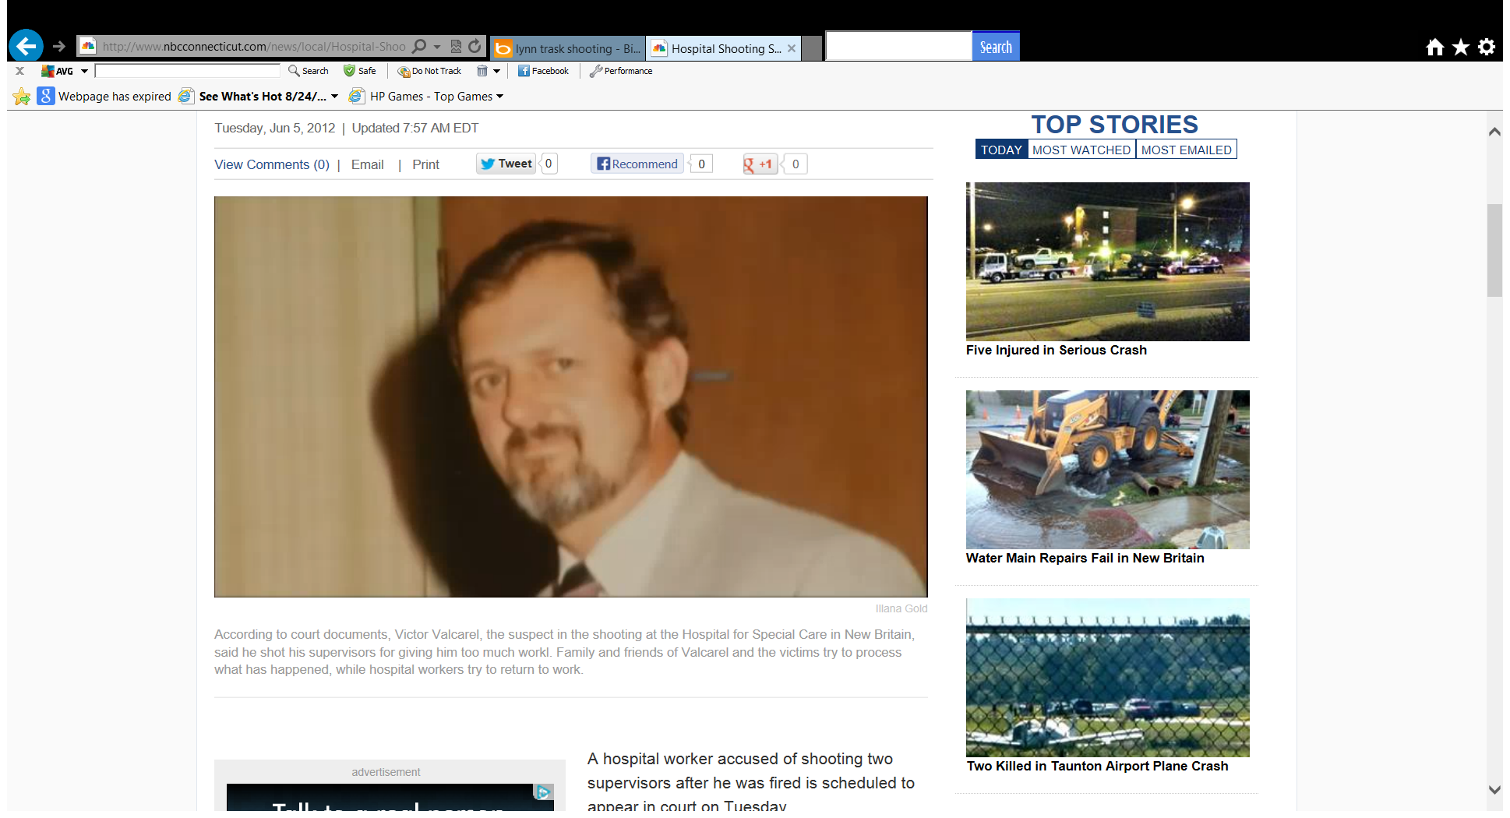
Case Study:
Hospital for Special Care-New Britain, CT
Robert Barucci 53 and Lynn Trask 65, building services supervisors at the hospital, were shot by Victor Valcarcel Sr. after disciplining him.
Robert Barucci
Lynn Trask

Slide 20
TRAINING FOR ACTIVE SHOOTERS
PHASE® and CAVE® incidents
The “4 OUTS”
  Get out
  Hide Out
  Keep Out
  Take Out
Active Shooter Safety Action Plan
Patient Safety vs. Self Preservation
Recovery

Slide 21
Violence Risk Assessments
McArthur Research Network Findings:
Gender. Men were somewhat more likely than women to be violent, but the difference was not large. Violence by women was more likely than violence by men to be directed against family members and to occur at home, and less likely to result in medical treatment or arrest.
Prior violence. All measures of prior violence strongly related to future violence.
Childhood experiences. The seriousness and frequency of having been physically abused as a child predicted subsequent violent behavior, as did having a parent – particularly a father – who was a substance abuser or a criminal.

Slide 22
Violence Risk Assessments
Neighborhood and race. African Americans and whites who lived in comparably disadvantaged neighborhoods had the same rates of violence.
Diagnosis. A diagnosis of a major mental disorder -- especially a diagnosis of schizophrenia -- was associated with a lower rate of violence than a diagnosis of a personality or adjustment disorder. A co-occurring diagnosis of substance abuse was strongly predictive of violence.
Psychopathy. Psychopathy was more strongly associated with violence than any other risk factor studied. The “antisocial behavior” component of psychopathy, rather than the “emotional detachment” component, accounted for most of this relationship.
Delusions. The presence of delusions – or the type of delusions or the content of delusions – was not associated with violence.

Slide 23
Violence Risk Assessments
Hallucinations. Neither hallucinations in general , nor “command” hallucinations per se, elevated the risk of violence. If voices specifically commanded a violent act, however, the likelihood of violence was increased.
Violent thoughts. Thinking or daydreaming about harming others was associated with violence, particularly if the thoughts or daydreams were persistent.
Anger. The higher a patient anger level, the more likely he or she is to be violent.

Slide 24
How Would You Respond?
An intoxicated male, brought in by police for no reason other than being intoxicated, demands to be placed in a cardiac room, convinced that they have “more comfortable beds”.

Slide 25
How Would You Respond?
A behavioral health patient in the ED demands to be taken outside for a cigarette, or she will “burn the whole place down”
An intoxicated visitor tells the receptionist in the ED that “I know where you park and when you will be walking out to your car”…

Slide 26
How Would You Respond?
A nurse removes a catheter from a patient, and as she turns away, the patient attacks her from behind
An unruly patient, suspected of being under the influence of a foreign substance, is place in restraints on the orders of the ED doc. 20 minutes later, the patient’s physician, who is a friend of the family, arrives and demands that the patient be taken out of restraints, even though the patient is still making threats to the staff what he will do to them once he is released.

Slide 27
WORKPLACE VIOLENCE
Incidents of healthcare violence may be similar to other workplace settings or very unique to the
population served
All scenarios discussed have the potential to be
catastrophic in nature
Understanding the issues and what to look for
enables us to avoid or mitigate negative outcomes

Slide 28

Incidents of Workplace Violence are equally catastrophic in nature, but can be avoided, if we understand the issues, and know what to look for.

Slide 29
Facts
60% of workplace assaults occur in the health care setting; 75% of these assaults are by patients or residents
43% of ED nurses have reported a violent incident in their workplace in the last 3 years. 72% said they received no support from the hospital after.
More and more states are enacting legislation to protect healthcare workers; Virginia now is mandatory 48 hour incarceration for assaulting a healthcare professional.
Approximately 900 deaths and 1.7 million non fatal assaults occur in the work place a year.

Slide 30
NIOSH Study Finds…
Violence in hospitals is over four times the national average for non-health care workplaces
Violence is most common in psychiatric facilities and emergency departments

Slide 31
What Constitutes Workplace Violence?
In simplest terms:
Any incident in which an employer or employee is threatened, intimidated, verbally or physically attacked, harassed, injured or killed

Slide 32
Always Remember
Incidents of Workplace Violence can be avoided, if we understand the issues and know what to look for.

Slide 33
PREVENTING
WORKPLACE VIOLENCE
THE GOLDEN RULE:
IN EVERY HEALTHCARE FACILITY, THE RISK OF VIOLENCE SHOULD ALWAYS BE RECOGNIZED, BUT CAN ALWAYS BE AVOIDED OR MITIGATED THROUGH PREPARATION

Slide 34
Responding To A
Violent Situation
To increase safety and lessen your chances of being injured, follow some simple guidelines:
  Practice prevention as a primary goal
  Train all employees on prevention techniques
  Focus on effective verbal de-escalation
  Limit physical interventions
  Use an adequate number of trained staff
  Train emergency response teams using a variety of training methods

Slide 35
Characteristics of the Potentially Violent Person
Male
Caucasian
Working Age
  80%Probability
  75% Probability
  90% Probability

Slide 36
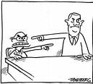

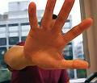

Characteristics of the Potentially Violent Person
90% Will Display One Or More Of The Following
Pathological Blaming
Depression
Personality Disorder
History of Violence

Slide 37




Characteristics of the Potentially Violent Person
90% Will Display One Or More Of The Following
Erotomania
Interest in weapons
Chemical Dependence
Alcohol dependence

Slide 38



Characteristics of the Potentially Violent Person
90% Will Display One Or More Of The Following
Elevated Frustration Levels
Impaired Neuro Functions
Evidence of Psychosis

Slide 39
Prevention Starts HERE
Key to prevention of violence:
  Connect with the patient during a calm, non-threatening time
  Begin at the moment of contact with your facility
  Conduct every interaction in a kind, caring, and empathetic manner
  Ask yourself, “how can I best help this person?”
Notes:
It is critical to focus our energy here
At the triage desk, providers listen carefully to identify and categorize patients according to diagnosis. It is important to be attentive to what the patient is feeling in order to uncover or identify real patient needs.
John shared this story.

Slide 40
Recognizing and Avoiding Potentially Violent Behavior
The Aggression Continuum:
Six Steps from Calm to Violent

Slide 41
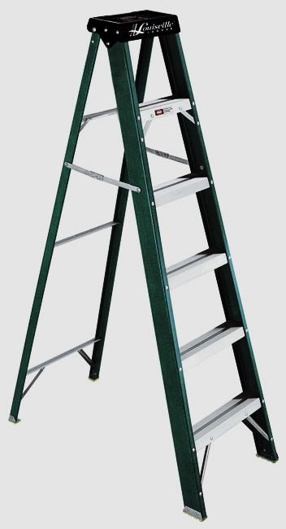
The Aggression Continuum
The continuum can best be thought of as a six foot step ladder. The closer the aggressor gets to the top rung, the more likely the risk of violent behavior.

Slide 42
The Aggression Continuum
Remember what the sticker on the top step says:
DANGER
Do Not Stand Here

Slide 43
The Aggression Continuum
STEP 1:
the Person is
Calm
  Calm

Slide 44
The Aggression Continuum
Step 1: Calm and Non-Threatening
  Persons Action:
  Presents in a calm manner
  Not agitated
  Presence is not threatening
  Is just “another person functioning in society”

Slide 45
The Aggression Continuum
Step 1: Calm and Non-Threatening
  Your Response:
    Respect the person’s dignity
    Actively listen to concerns
    Demonstrate compassion and caring
    Focus on needs
    Build rapport

Slide 46
The Aggression Continuum
STEP 2:
the Person is
Verbally
Agitated
  Verbally Agitated
  Calm

Slide 47
The Aggression Continuum
Step 2: Verbally Agitated
  Persons Actions:
  person expresses verbal anger
  the anger is not directed at any specific person or object
  the person is no threat to you

Slide 48
The Aggression Continuum
Step 2: Verbally Agitated
  Your Response:
  Listen To The Person
  Respect The Person
  Save The Person’s Self Esteem
  DO NOT Give Orders

Slide 49
The Aggression Continuum
STEP 3:
the Person is
Verbally
Hostile
  Verbally Hostile
  Verbally Agitated
  Calm

Slide 50
The Aggression Continuum
Step 3: Verbally Hostile
  Persons Actions:
    Similar to being “verbally agitated”
    Oblivious to calming efforts
    Generalized statements
      This @$%*! Place!
      You @%&*! People!
      Use of “always” and “never”
    Verbally agitated + emotion = Verbally Hostile

Slide 51
The Aggression Continuum
Step 3: Verbally Hostile
  Your Response:
  Maintain non-threatening body posture
  Respect the “personal zone”
  Allow the person to vent anger
  Keep your instructions minimal
  Continue to make collaborative statements (What can we do to manage this situation?)
  Keep discussion specific to here and now

Slide 52
The Aggression Continuum
STEP 4:
the Person is
Verbally
Threatening
  Verbally Threatening
  Verbally Hostile
  Verbally Agitated
  Calm

Slide 53
The Aggression Continuum
Step 4: Verbally Threatening
  Persons Actions:
  Begins to focus anger on specific person(s)
  Makes demands for action
  Makes threats of consequences if demands are not met

Slide 54
The Aggression Continuum
Step 4: Verbally Threatening
  Your Response:
  Maintain eye contact
  Avoid cornering the person
  Give person options
  Triangular positioning
  ANTICIPATE VIOLENCE

Slide 55


Triangle Approach
Back Up #1
Back Up #2
Aggressor
In Charge

Slide 56
CORNERING
To corner the person means to trap the person. To remember the dangerous methods of cornering, remember the acronym C-A-P-E:
C - Contact Cornering
A - Angular Cornering
P - Psychological Cornering
E - Exit Cornering

Slide 57
The Aggression Continuum
STEP 5:
the Person is
Physically
Threatening
  Physically Threatening
  Verbally Threatening
  Verbally Hostile
  Verbally Agitated
  Calm

Slide 58
The Aggression Continuum
Step 5: Physically Threatening
  Persons Actions:
  Takes stance that suggests violence
  May scan area for potential weapons
  May make aggressive moves against you

Slide 59
The Aggression Continuum
Step 5: Physically Threatening
  Your Response:
  Must recognize this is the critical point
  Maintain defensive posture
  Look for strong side/weak side indicators
  Be prepared for physical attack

Slide 60
Strong Side / Weak Side Indicators
Strong side indicators:
Wallet on strong side (m), purse on strong side (f)
Phones and pagers on strong side (b)
Shoulder dipped lower strong side (b)
Weak side indicators:
Pens/pencils/cigarettes (m)
Tip of belt points to weak side (m)
Part hair on weak side (m)
Wears watch on weak side (b)
Stands with weak side foot forward (b)

Slide 61
The Aggression Continuum
  Physically Violent
STEP 6:
the Person is
Physically
Violent
  Physically Threatening
  Verbally Threatening
  Verbally Hostile
  Verbally Agitated
  Calm

Slide 62
The Aggression Continuum
Step 6: Physically Violent
  Persons Actions:
  Physically attacks you in some form

Slide 63
The Aggression Continuum
Step 6: Physically Violent
  Your Response:
  Change to self defense/survival mode

Slide 64
Self Defense vs. Patient Control
Self Defense involves any and all means of self protection
  Force used must be reasonable and necessary
  Tactics aid in the escape of an individual from an
  attacker without regard for the attacker
  Used only in emergency situations to protect the
  provider from harm or injury
Patient Control
  Tactics to maximize patient management while
  minimizing injury to patients and other providers
  Professional responsibility to protect and defend
Notes:
It is critical to distinguish between Self Defense tactics and Patient Control techniques.
Self defense tactics are only used in emergent situations where the provider is in imminent danger of great bodily harm or death.
Patient Control techniques are the techniques that have been developed to maximize provider control while minimizing risk injury to patients or other providers
Examples:
The provider is alone in the room with the patient and the patient takes control of the provider putting him/her in a life-threatening chokehold – this is imminent danger and requires self defense tactics
The patient grabs the provider by the hair – this in and of itself is NOT imminent danger and requires patient control techniques
These scenarios place the responsibility on the provider (as a reasonable person) to select the method that protect the patient as well as themselves.

Slide 65
Objective “Reasonableness”
Force is judged:
From standpoint of a reasonable provider/security officer with similar training and experience
Through the eyes of the provider/security officer at the seen, at the time
Objective determination
Notes:
Objective Reasonableness Standard
1. Force must be judged from the perspective of a reasonable provider/security officer with similar training and experience.
2. Force judged through the eyes of the provider/security officer at the scene, at the time. No 20/20 hindsight.
3. Standard is objective. Are provider/security officers actions reasonable in light of circumstances, without regard to underlying intent.
4. Did the provider/security officer act properly under law at time.

Slide 66
Ten De-Escalants To Apply
1. Commitment To Outcome
2. Pay Attention
3. Know The Aggression Continuum
4. Assessing The Cause
5. Avoid Ego Battles

Slide 67
Ten De-Escalants To Apply
6. Monitor Status
7. Monitor The Environment
8. Offer Options / Choices
9. Avoid Cornering – I.E. C.A.P.E
10. Establish Leadership (Who’s In Charge)

Slide 68
Responding to Potentially Violent Incidents
THE BUDDY SYSTEM:
When responding to a situation that you know may become violent or involve aggressive behavior, always use a buddy system. A minimum of two people, but 3 or more is even safer.

Slide 69
If You Are Involved In A Violent Situation
First, obtain any necessary medical attention you may need.
Report the incident to your supervisor
Complete a Violent Incident Report Form and turn it in to your supervisor

Slide 70
If You Have An Incident…
Talk about it!
Watch for signs of Post Traumatic Stress Disorder
Utilize CISD Teams
Utilize EAP programs
Utilize Crisis Intervention Teams
Critique each session from Quality Improvement perspective

Slide 71
Recovery:
Unplanned and Untested
Elements of a Recovery Plan:
  Cleanup
  Counseling for employees / survivors
  Media assistance / Public relations
  Legal / Risk Management
  Additional / supplemental security services
  Cyber “listening” services
  Training and exercising!!!

Slide 72
QUESTIONS / COMMENTS
Steve Wilder
Sorensen, Wilder & Associates
Bourbonnais, IL 60914
815-482-2989 (cell)
swilder@swa4safety.com
www.swa4safety.com
@SorensenWilder

