Slide 1
MIOSHA Update for Inpatient Healthcare Settings
Barton G. Pickelman, CIH, MIOSHA Deputy Director
This information is intended to provide general guidelines for educational purposes. It is not intended and should not be construed as legal or medical advice. The viewpoints expressed in this presentation are those of the speaker and are not necessarily views endorsed by the Michigan Health Care Safety Association.

Slide 2

www.mhcsa.org
MHCSA: Who we are

Slide 3
2016 MHCSA Quarterly Meetings
Friday, March 11, 2016
Thursday, June 16, 2016
Friday, September 16, 2016
Friday, November 4, 2016 - Conference
$25 Annual Membership
To apply, see website at www.mhcsa.org.

Slide 4
For More Information

Slide 5

Our Speaker
Barton G Pickelman, CIH
MIOSHA Deputy Director
Michigan Department of Licensing & Regulatory Affairs

Slide 6

MIOSHA Update for Inpatient Healthcare Settings
Presented by
Barton G. Pickelman, CIH
MIOSHA Deputy Director

Slide 7
Agenda
Background
  Injury and Illness Rates
  MIOSHA Strategic Plan
Former National Emphasis Program
New OSHA Guidance Document
Focus of Inspections

Slide 8
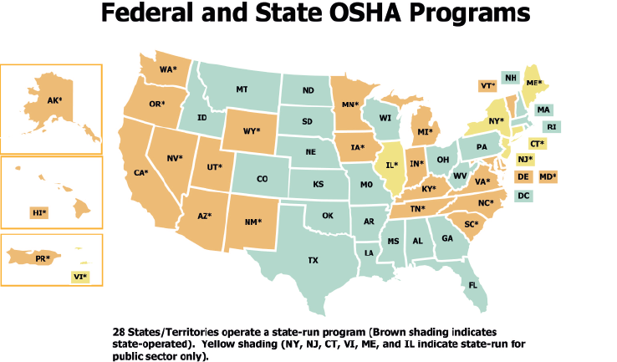
Federal OSHA vs. State Plans

Slide 9
Regulatory Changes –
Relationship to Federal OSHA
State Plan Agreement
6 Months allowance to implement changes
New standards/rules
Compliance Instructions
Interpretations

Slide 10
MIOSHA Strategic Plan
Current plan covers FY2014 to 2018
Strategic Plan Objective 1.1 – Reduce the I&I rate in high-hazard industries by 15%
High-hazard industries are those with I&I rates above the Michigan average
Utilize consultative and enforcement resources

Slide 11
Injury and Illness Rates
2014 Michigan Average Rate for Public and Private Employers = 3.7
Means 3.7 out of every 100 workers are injured or become ill
2014 Rate for Hospitals (NAICS 622) = 7.0
2014 Rate for Nursing and Residential Care Facilities (NAICS 623) = 7.8

Slide 12
Strategic Plan Results/Activities
Hospitals
  19 Inspections covering 7,320 workers
  Baseline I&I Rate (2012) = 7.5
  Current I&I Rate (2014) = 7.0
Nursing and Residential Care Facilities
  26 Inspections covering 2,059 workers
  Baseline I&I Rate (2012) = 9.6
  Current I&I Rate (2014) = 7.8
Good progress but more to do!

Slide 13
Nursing and Residential Care Facility National Emphasis Program(NEP):
Scope and Purpose
Scope: Impacts all federal OSHA and state-plan states (e.g., Michigan).
Purpose: Implements programmed inspections of:
  Skilled Nursing Care Facilities (NAICS 6231);
  Residential Care Facilities (NAICS 6232);
  Continuing Care/Assisted Living Communities (NAICS 6233)
Detailed hazards to focus on during inspections
NEP ended April 2015

Slide 14
New OSHA Guidance Document
Inspection Guidance for Inpatient Healthcare Settings – Issued June 25, 2015
State Plans expected to follow
Same hazards focus as old NEP
Includes Nursing and Residential Care Facilities (NAICS 623)
Includes Hospitals (NAICS 622)

Slide 15

Inpatient Healthcare Settings
Main Hazards Focus
Musculoskeletal Disorders/Ergonomic Stress
Workplace violence (assaults to staff)
Bloodborne Pathogens (cited most)
Tuberculosis
Slips, Trips, and Falls
Note – No MIOSHA standards specific to:
  Musculoskeletal Disorders/Ergonomics
  Workplace Violence
  Tuberculosis
  Addressed via General Duty Clause

Slide 16


Inpatient Healthcare Settings
Other Hazards Focus
Multi-drug resistant organisms (MDROs) such as Methicillin-Resistant Staphylococcus Aureus (MRSA).
Hazardous Chemicals
  Disinfectants/Sanitizers
  Hazardous Drugs

Slide 17
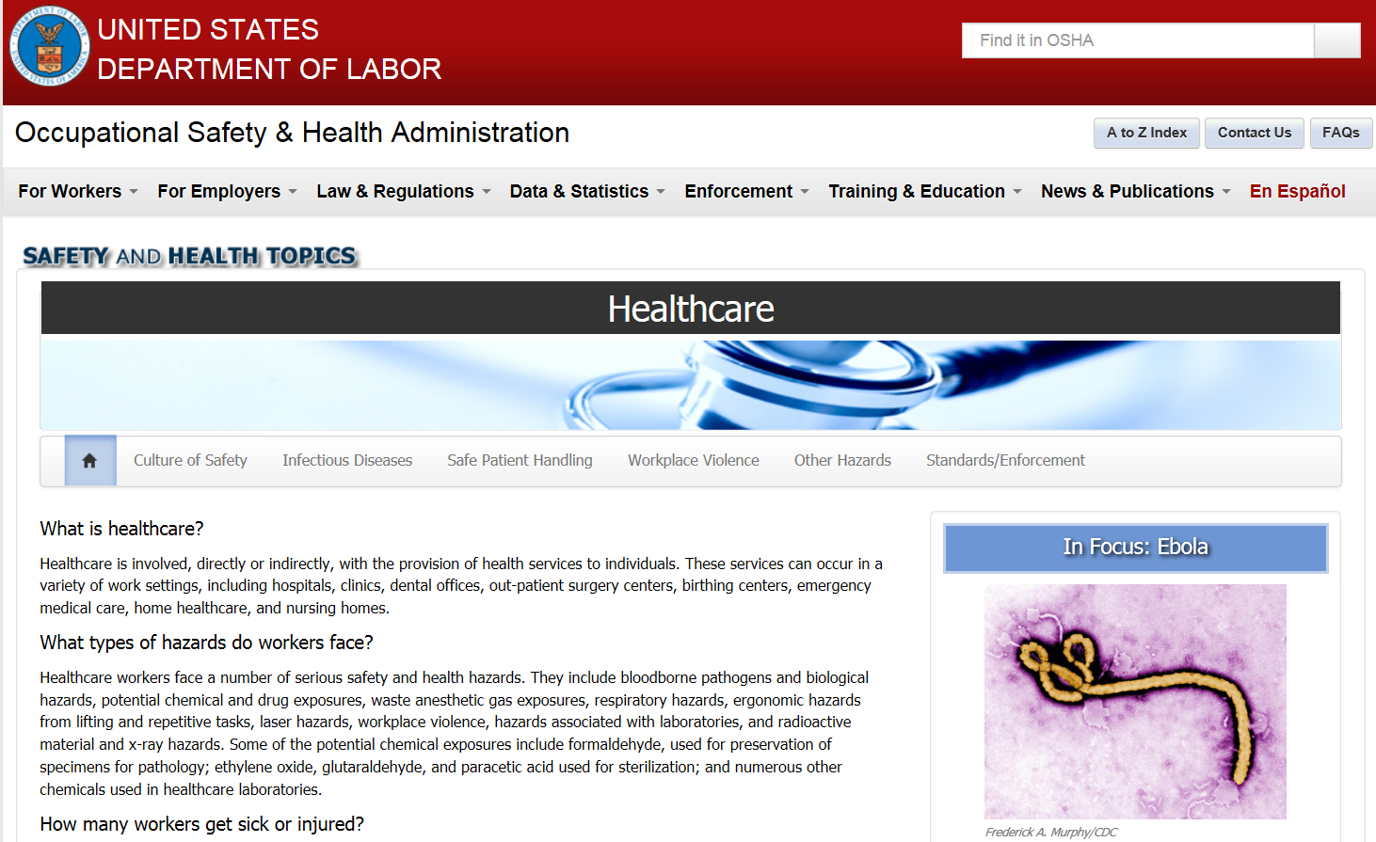
Resources
OSHA’s Healthcare Safety and Health Topics

Slide 18
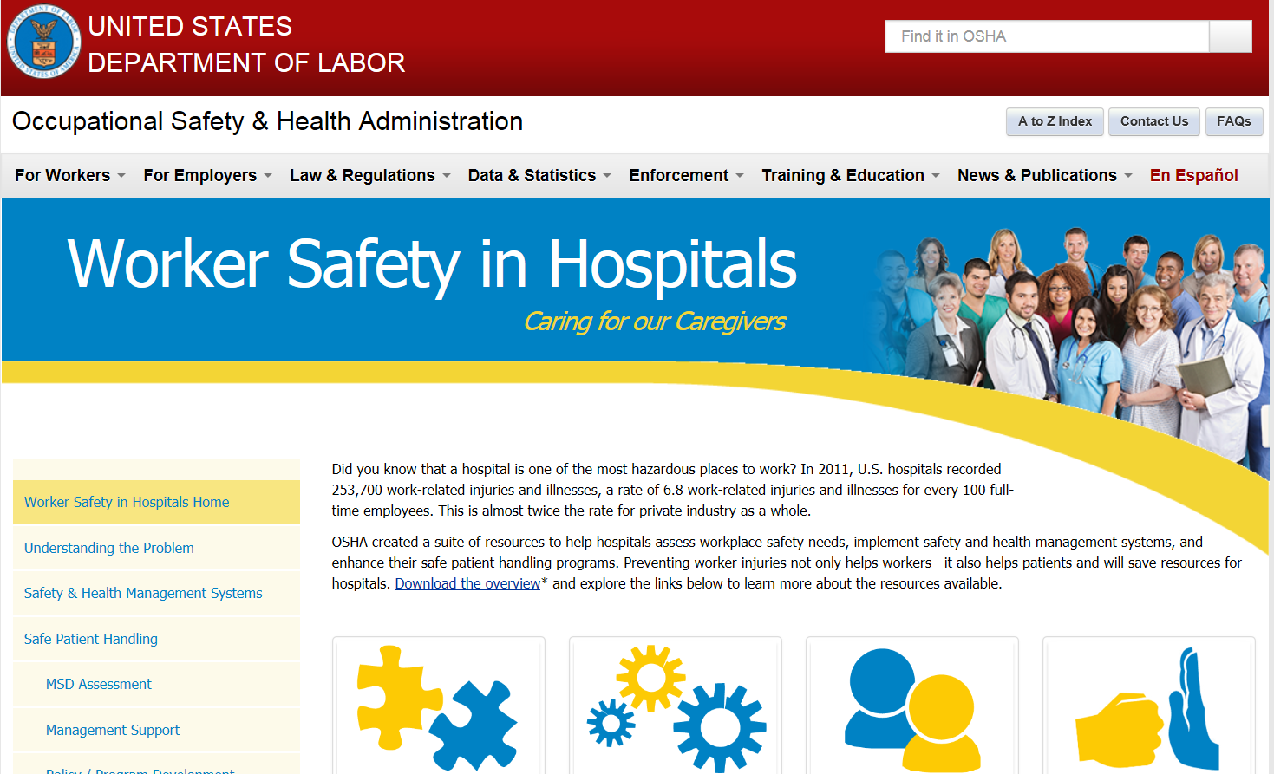
Resources
Worker Safety in Hospitals

Slide 19
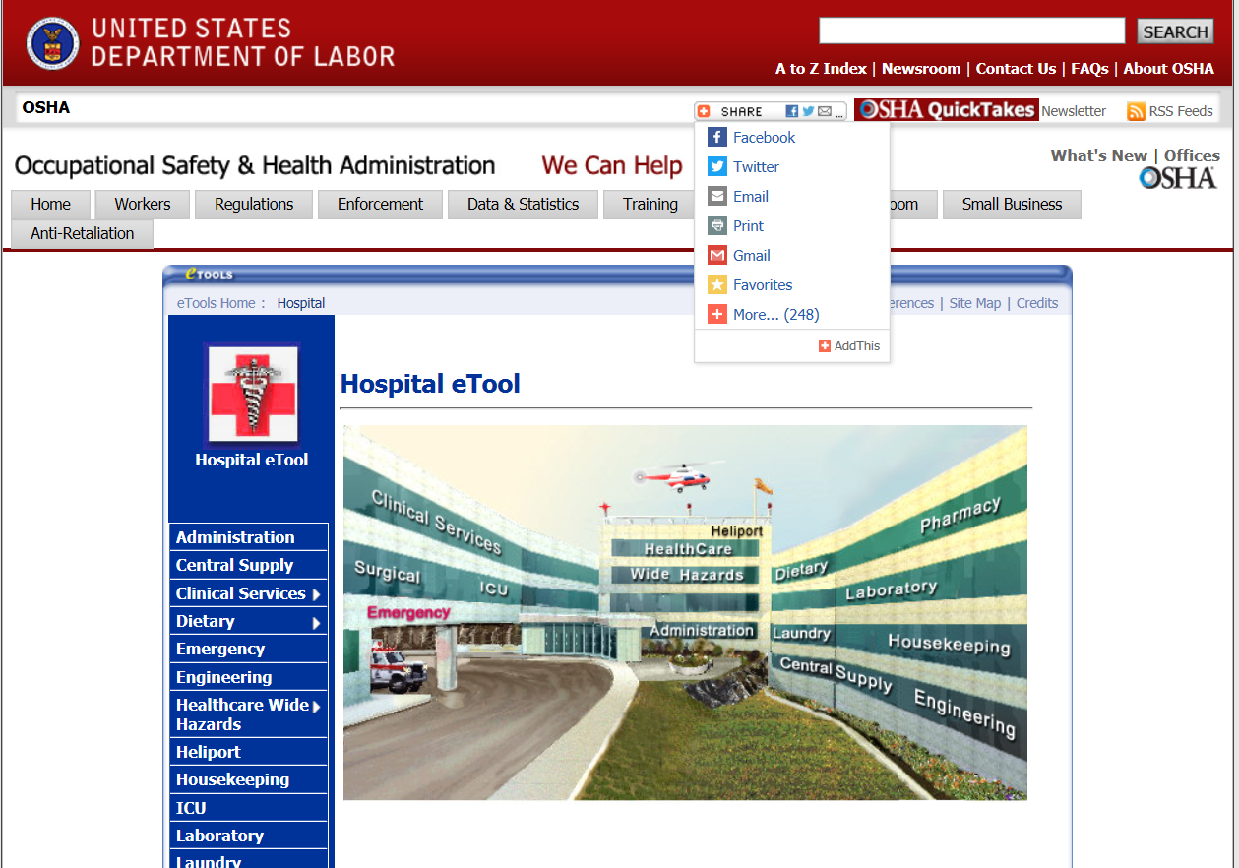
Resources
OSHA's Hospital eTool

Slide 20
Bloodborne Infectious Diseases
Revised Rules Effective October 2014.
The following include changes to the MIOSHA BID Standard as recommended by the Michigan Office of Regulatory Reinvention (ORR).
ORR looked at MIOSHA rules that went beyond federal OSHA requirements.

Slide 21
Part 554 Bloodborne Infectious Diseases
Number of Citations
Number of Citations | FY 2013 | FY 2014
Exposure Control Plan | 21 | 12
Vaccines and Post Exposure | 14 | 11
Information and Training | 14 | 7
Recordkeeping | 10 | 10
Exposure Determination | 8 | 9
Waste Disposal | 2 | 1
Work Practice | 1 | 0
Protective clothing | 1 | 0

Slide 22
Rule 3. Exposure Determination
An employer shall:
Evaluate routine and reasonably anticipated tasks and procedures to determine:
  Actual or reasonably anticipated employee exposure to blood or OPIM
  Category A or B
Make determination without regard to PPE
Document rationale for determination (10/2014 revision)
Maintain a list of all Category A job classes

Slide 23
Exposure Control Plan
Must be:
  Written and reviewed by knowledgeable person annually
  Accessible to Category A personnel

Slide 24
What information is contained in an
Exposure Control Plan?
Exposure Determination
Summary of the training program
Procedures for evaluating exposure incidents
Task-Specific SOP’s to include:
  Employee recognition of exposure
  Personal Protective Equipment (PPE) selection, use, maintenance, and disposal
Task-specific SOPs for management of inadvertent exposures such as needlesticks

Slide 25
Exposure Control Plan - Healthcare
Healthcare facility exposure control programs must:
Reflect changes in technology that eliminate or reduce exposure to bloodborne pathogens
Document annually consideration and implementation of safer devices that are:
  Appropriate
  Commercially available
  Effective
Healthcare must solicit input from non-management personnel

Slide 26

Rule 7. Work Practices
Handwashing:
  Immediately after removing gloves or other protective clothing
  After contact with blood or OPIM
  Upon leaving the work area (10/2014 revision)
  As soon as feasible after use of antiseptic hand cleansers when washing facilities were not available

Slide 27
Rule 8. Protective Clothing and Equipment
(f) An employee shall wear gloves if there is a reasonable anticipation of direct skin contact with blood, other potentially infectious material, mucous membranes, or non-intact skin of patients……
Gloves shall be changed between patient contacts.
(l) To minimize the need for direct mouth-to-mouth resuscitation, pocket masks, resuscitation bags, or other ventilation devices shall be provided in strategic locations and to trained personnel where the need for resuscitation is likely.
Notes:
Infection control for patient safety under facility license regulated by LARA Health Systems.
(l) Changes in CPR where month-to-mouth is changing to compressions only.

Slide 28
Rule 11. Laundry
Laundry workers in health care settings are usually category A and must be supplied and use PPE when handling contaminated laundry.
Follow universal precautions.

Slide 29

Rule 13. Vaccinations
Within 10 days of initial assignment each category A employee must be offered:
  HBV vaccination
  If an employee declines vaccination the employer must have a signed declination form

Slide 30
Other Standards
Although not specifically listed in the OSHA guidance document, the following are other standards that may be addressed during an inspection.
  Hazard Communication
  Personal Protective Equipment
  Recording and Reporting of Occupational Injuries and Illnesses

Slide 31

Hazard Communication
Revised December,2012

Slide 32
Safety Data Sheets (SDSs)
New 16-section standardized SDS format required (ANSI Z400.1)
Section 1 – Identification
Section 2 – Hazard(s) identification
Section 3 – Composition / Information on Ingredients
Section 4 – First-aid Measures
Section 5 – Fire-fighting Measures
Section 6 – Accidental Release Measures
Section 7 – Handling and Storage
Section 8 – Exposure Controls / Personal Protection
Section 9 – Physical and Chemical
Properties
Section 10 – Stability and Reactivity
Section 11 – Toxicological Information
Section 12 – Ecological Information*
Section 13 – Disposal Consideration*
Section 14 – Transport Information*
Section 15 – Regulatory Information*
Section 16 – Other information including date of preparation of last revision
*Sections outside of MIOSHA jurisdiction but inclusion of these sections is necessary for a GHS compliant SDS

Slide 33
Safety Data Sheets (SDSs)
Maintain for:
  Hazardous drugs (liquid or powdered)
  Disinfectants
  Oxygen
Consumer Products exemptions:
  Personal use items (i.e. hairspray)
  Other household products used for purpose and quantity intended in the home.
Contact manufacturer/distributor/supplier when required SDS not received

Slide 34
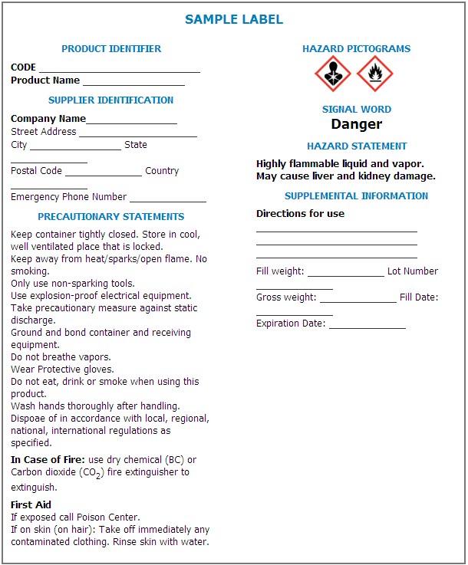
New Label Elements
Product identifier
Pictograms
Signal word
  Danger
  Warning
Hazard Statement
Precautionary Statements
Responsible party/ Supplier Identification
www.osha.gov/Publications/HazComm_QuickCard_Labels.html

Slide 35
Pictograms
Physical Hazard
Oxidizers
Flammables
Explosives
Corrosiv
e to Metal
Gases Under Pressure
Self Reactives
Self Reactives
P
yrophorics
Organic Peroxides
Self
-
Heating
Emits Flammable Gas
Organic Peroxides
Health Hazard
Environmental Hazard
Acute toxicity (severe)
Irritant
(skin and eye)
Carcinogen
Skin C
orrosion/
B
urns
Environmental Toxicity
Dermal Sensitizer
Respiratory Sensitizer
Serious
E
ye
D
amage
(acute and c
hronic)
Acute toxicity (harmful)
R
eproductive Toxicity
Narcotic Effects
Target Organ Toxicity
Respiratory Tract
Mutagenicity
Irritation
A
spiration Toxicity
Ozone Depleting (EPA)

Slide 36
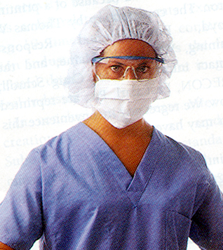
PERSONAL PROTECTIVE EQUIPMENT (PPE)
MIOSHA Parts 33 and 433:
Perform a hazard assessment to determine necessary PPE
Employee training on PPE
  Initial and when:
    Changes in workplace
    Changes in PPE
    Inadequacies in knowledge

Slide 37
PPE HAZARD ASSESSMENT CONT….
An employer shall:
Verify written PPE assessment certification which includes:
  Workplace evaluated
  Person who certified assessment
  Date of hazard assessment completion

Slide 38

PPE Hazard Assessment Elements
Workstation / Job Category
Hazard Source
Body Part Affected
Is PPE Required
Type of PPE Required

Slide 39
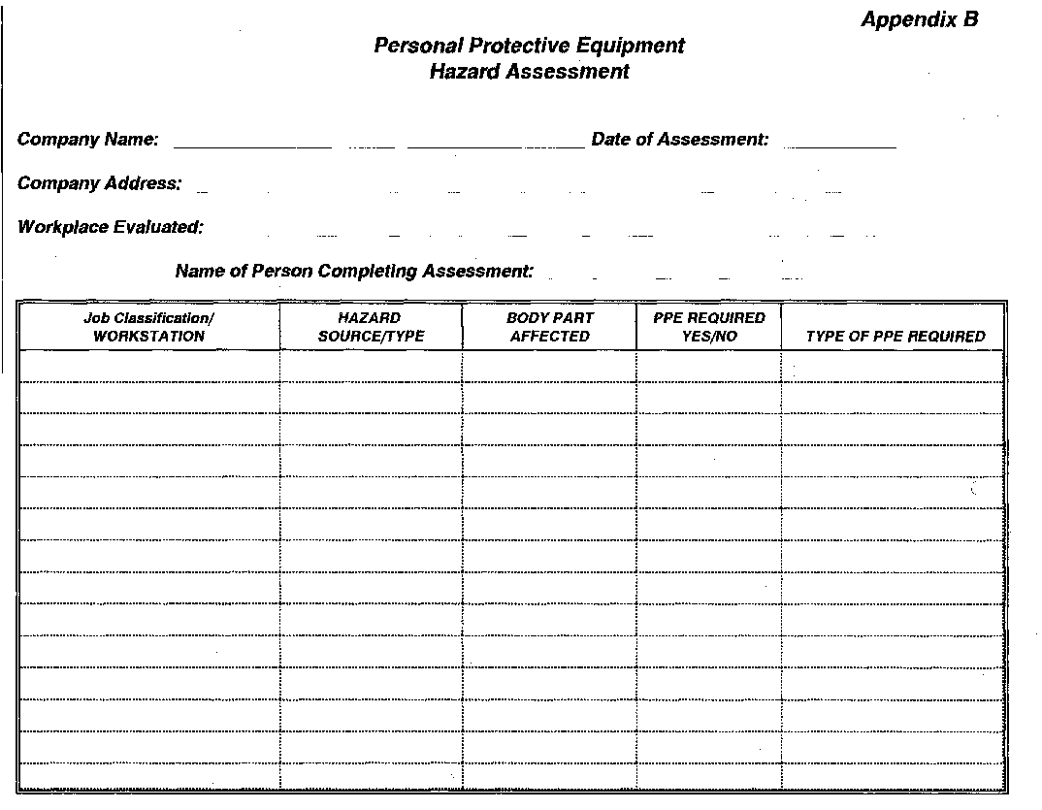

Slide 40
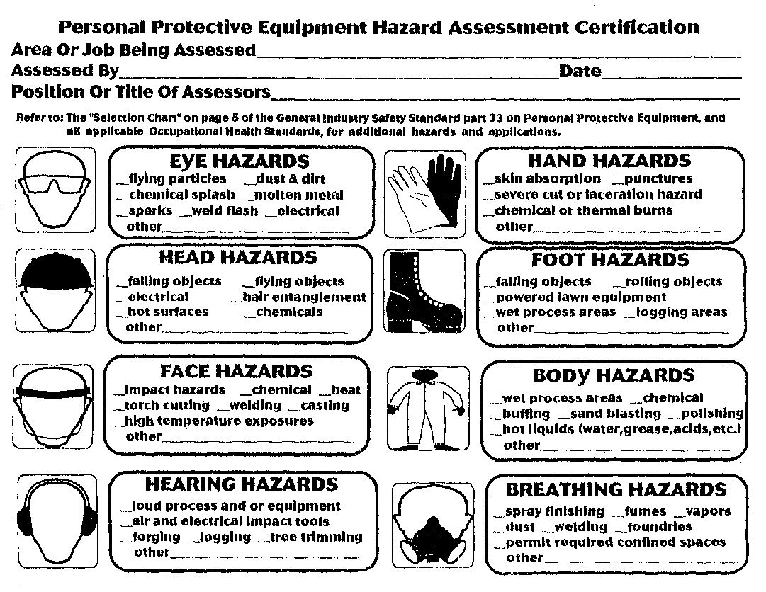

Slide 41
PPE Training Requirements
Employer shall provide training to each employee who is required use PPE:
  When PPE is necessary
  What PPE is necessary
  How to:
    Put it on (don)
    Take it off (doff)
    Adjust, and wear PPE

Slide 42
MIOSHA RECORDKEEPING
Part 11. Recording and Reporting Occupational Injuries and Illnesses

Slide 43
What Records Must Be Kept?
  Forms
    MIOSHA Form 300
      Log of work related injuries and illnesses
    MIOSHA Form 301
      Injury and illness incident report
    MIOSHA Form 300A
      Summary of work-related injuries and illnesses

Slide 44
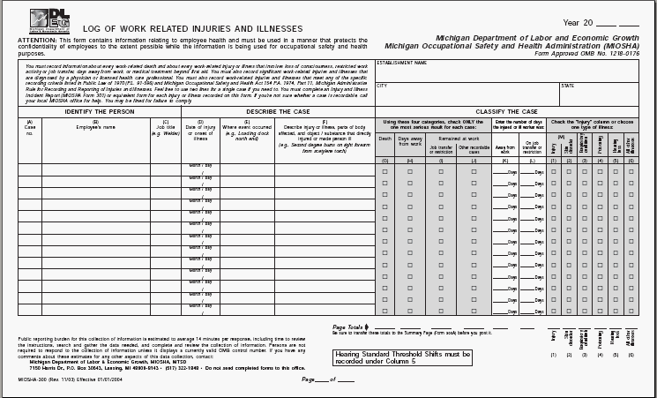
MIOSHA Log 300

Slide 45
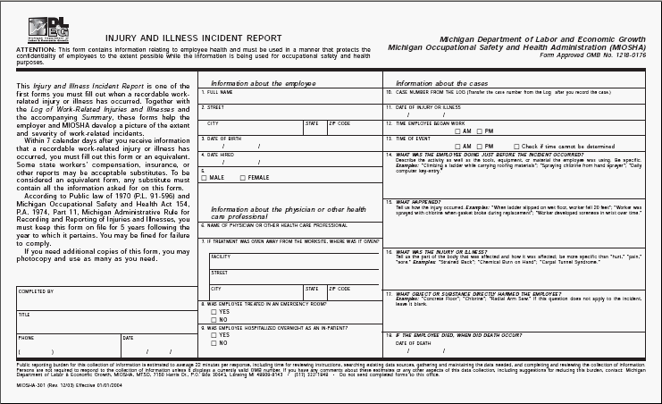
MIOSHA Log 301

Slide 46
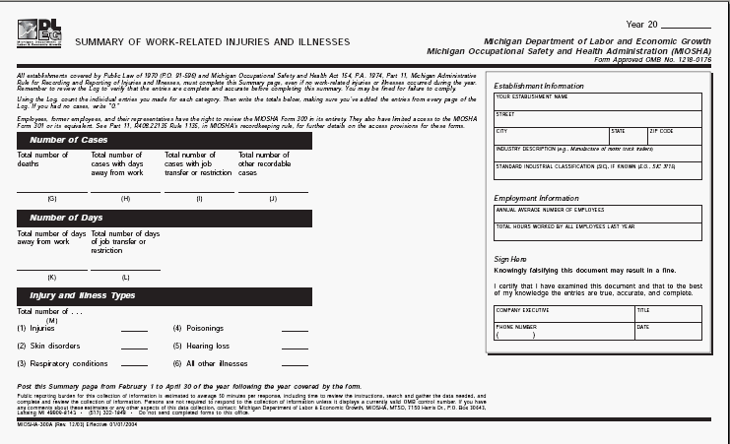
MIOSHA Log 300A – Posting form
Notes:
Certification
A company executive must certify the summary:
An owner of the company
An officer of the corporation
The highest ranking company official working at the establishment
The immediate supervisor of the highest ranking company official
Post between February 1 thru April 30 of the year following the year covered by the summary
Retain forms for 5 years following the year that they cover
Update the MIOSHA Form 300 during that period
Do not need to update the MIOSHA Form 300A or MIOSHA Form 301

Slide 47
Expanded Reporting Requirements
All work-related fatalities within 8 hours (same as current requirement)
All work-related in-patient hospitalizations of one or more employees within 24 hours
All work-related amputations within 24 hours
All work-related losses of an eye within 24 hours
Fatality Hotline 800-858-0397
I&I Reporting 844-464-6742

Slide 48
Recordkeeping Questions?
General Assistance
Forms
Posters
Information
www.michigan.gov/recordkeeping
Management Information Systems Section
(517) 284-7788

Slide 49

Questions and Assistance
MIOSHA Consultation Education and Training
(517) 284-7720
www.michigan.gov/miosha

