Slide 1
Keeping Your Hospital Healthy: Response to Water Damage
Michigan Health Care Safety Association
June 11, 2015
Connie A. Morbach, M.S., CIE, CHSP
Safety and Environment of Care Manager
McLaren Greater Lansing Hospital
connie.morbach@mclaren.org

Slide 2
WHAT WE WILL COVER
Categories of Water Damage
Most Likely Locations in Hospitals
Potential Health Related Risks in Hospitals
Water Damage Response
Professional Water Damage Restoration

Slide 3
Categories of Water Loss
As Defined by the Institute of Inspection Cleaning and Restoration Certification (IICRC)
Clean water 1
    Water that originates from a sanitary source and is not expected to cause harm to humans. Examples are all potable water, drinking water and water from supply pipes to appliances.
Category 2
    Water that contains significant contamination and has the potential to cause discomfort or illnesses if contacted or consumed by humans. Sink overflow, washing machine overflow, dishwasher discharge leak
    3. Category 3
    Water that is grossly contaminated and can contain pathogenic, toxigenic or other harmful agents. Examples include sewage , toilet overflows, roof leaks, ground water intrusion

Slide 4
Change In Category Of Water Loss With Time
The condition of a water loss can quickly degrade if affected building materials are not quickly dried
The category of water loss is not only determine by the origin of the water, but also by the contaminants that it comes in contact with as it flows through an indoor environment.
In addition to biological contaminants, water can become contaminated with pesticides and other potentially harmful substances.

Slide 6
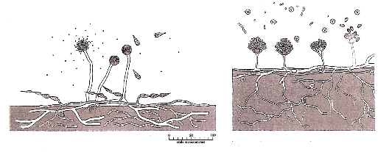

Slide 7
Most Likely Areas of Water Damage in Hospitals
Roof leaks, especially at penetrations
Plumbing leaks
Under sinks
Within ceiling assembly (AC units)
Condensation on Pipes
Ground Water Intrusion
Weather Related
Janitor Closets

Slide 8
Roof Leaks
At Penetrations
  Inspect frequently
  Check for worn or damaged caulking
  Clogged drains
  Water flow downward to drains
  Roof edges and flashings
  Membrane intact

Slide 9
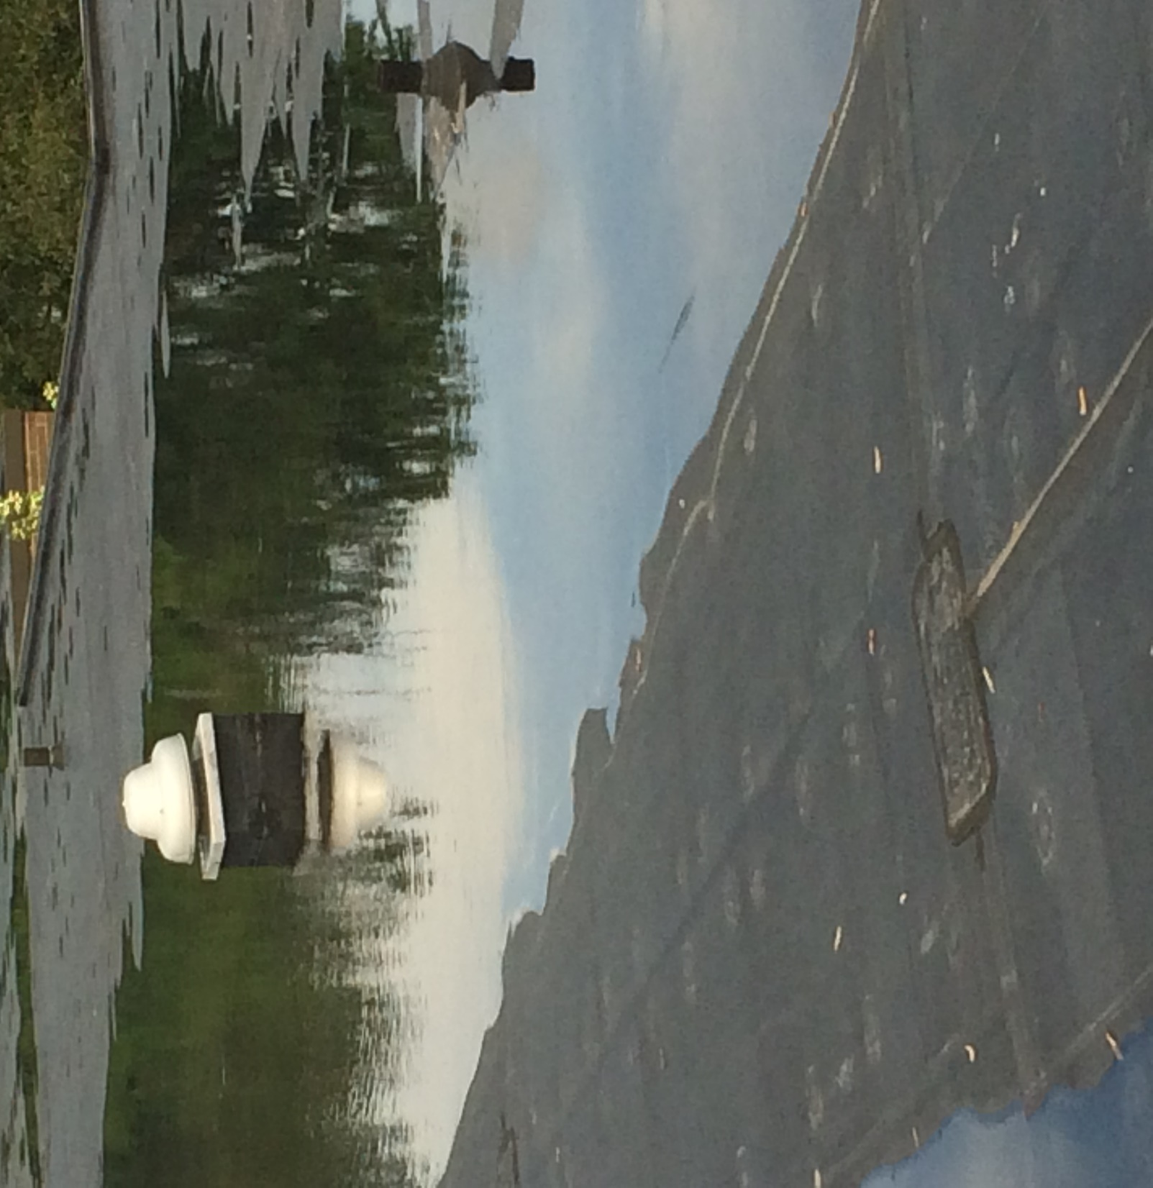

Slide 10
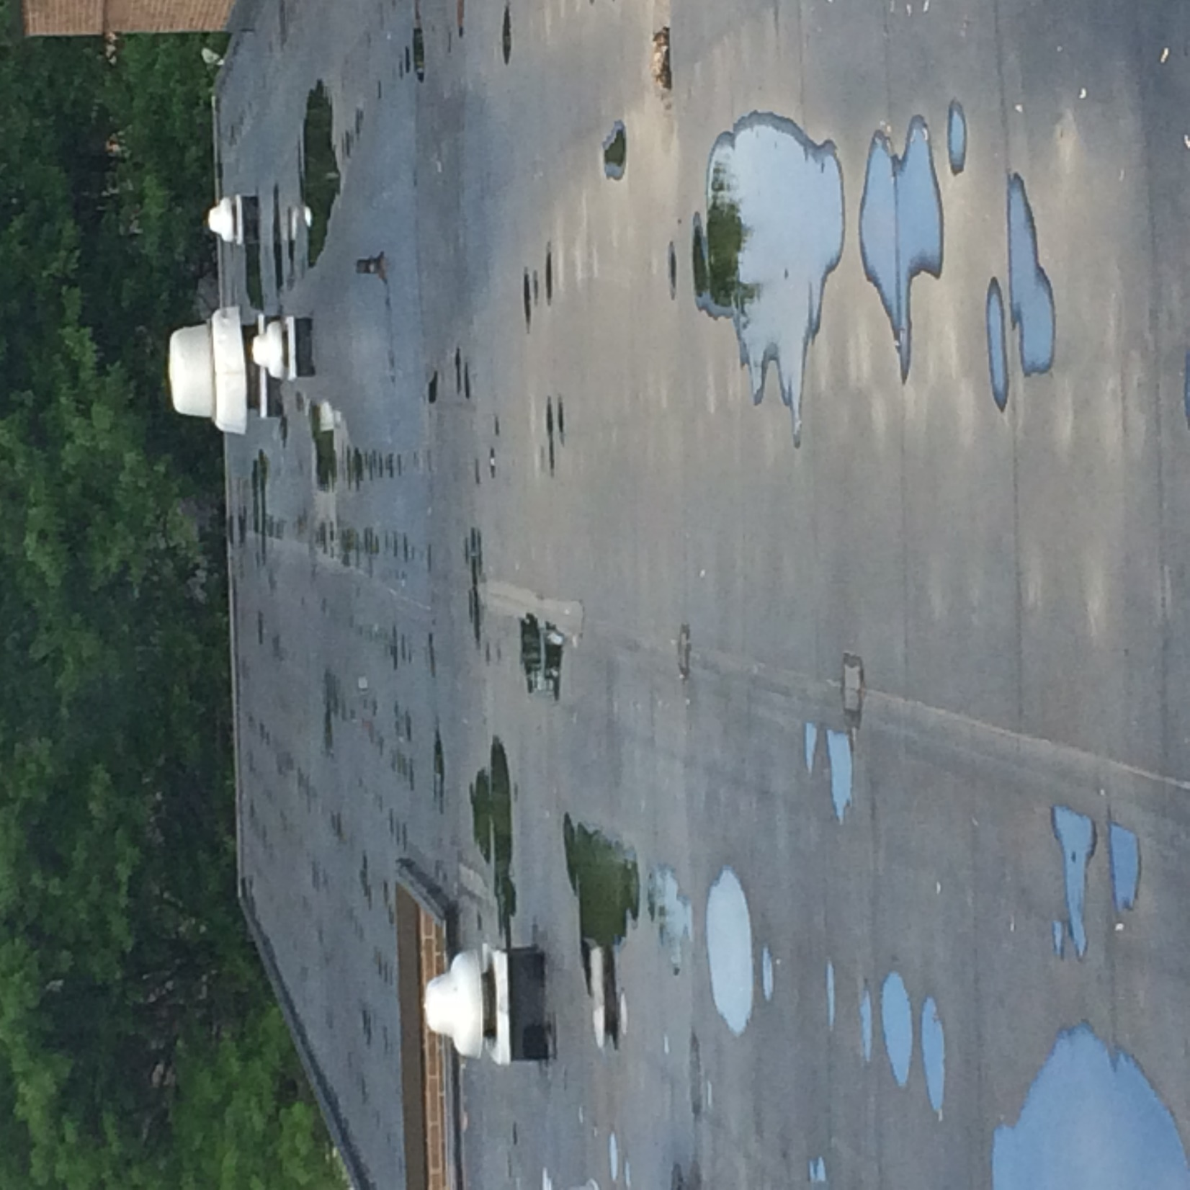

Slide 11
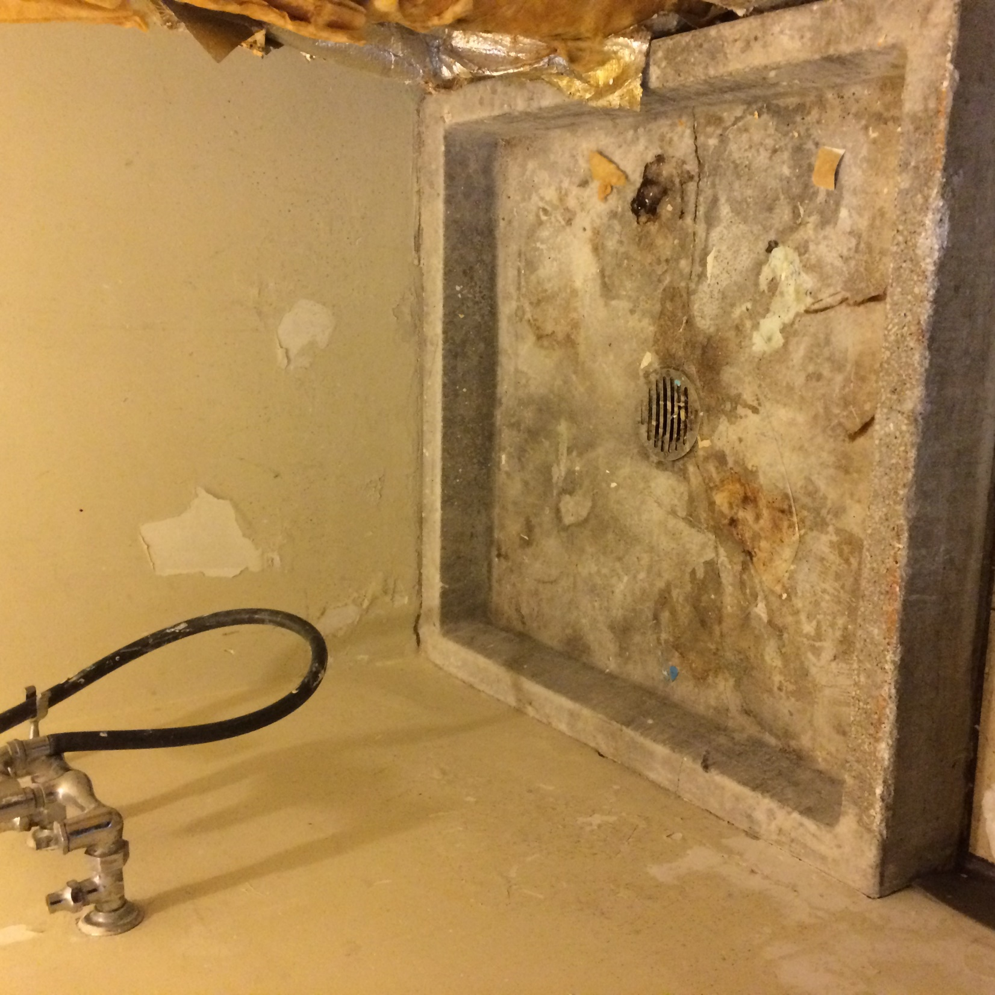

Slide 12
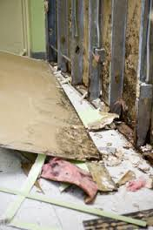

Slide 13
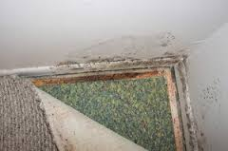

Slide 14
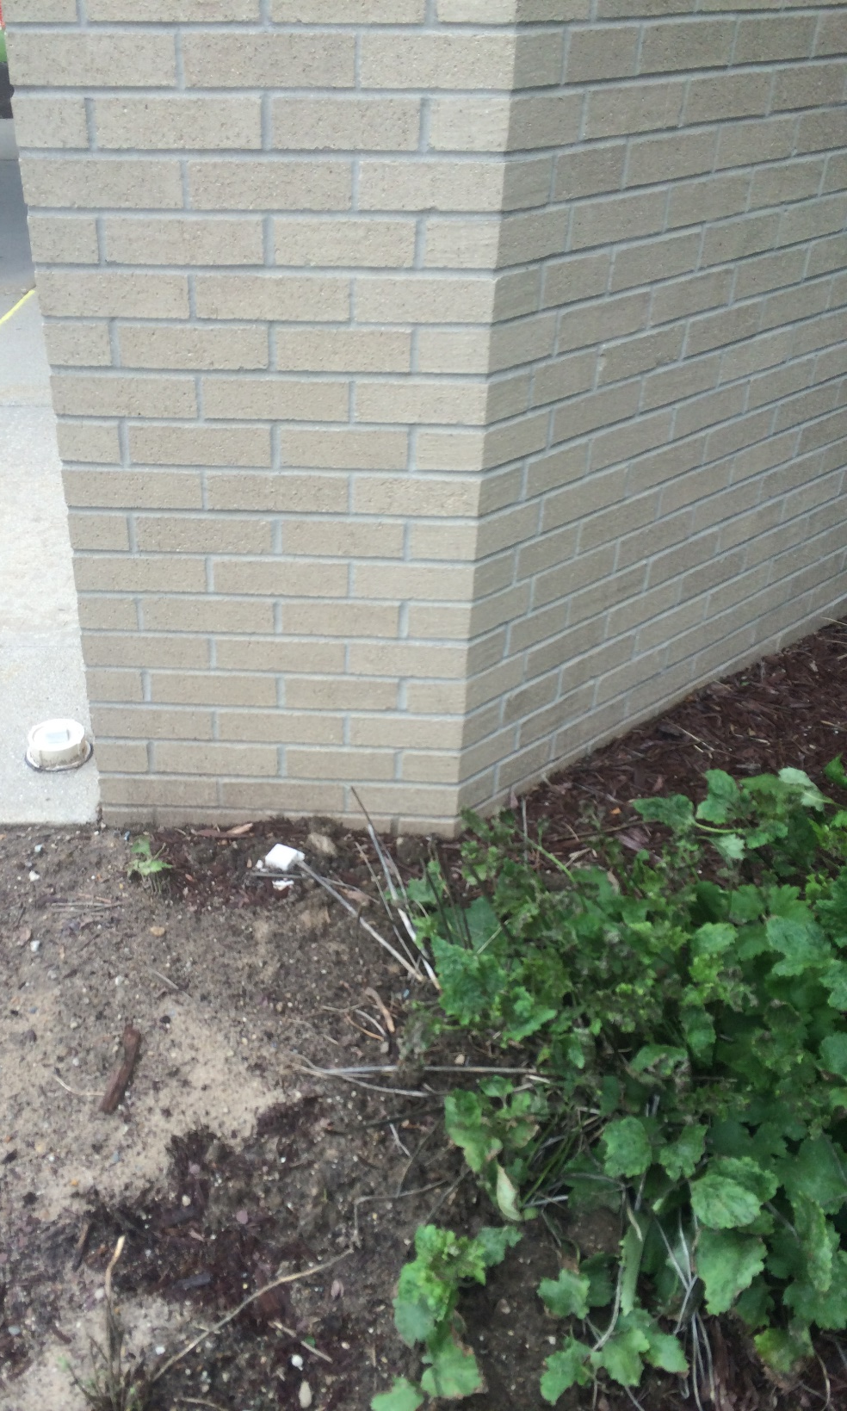

Slide 15
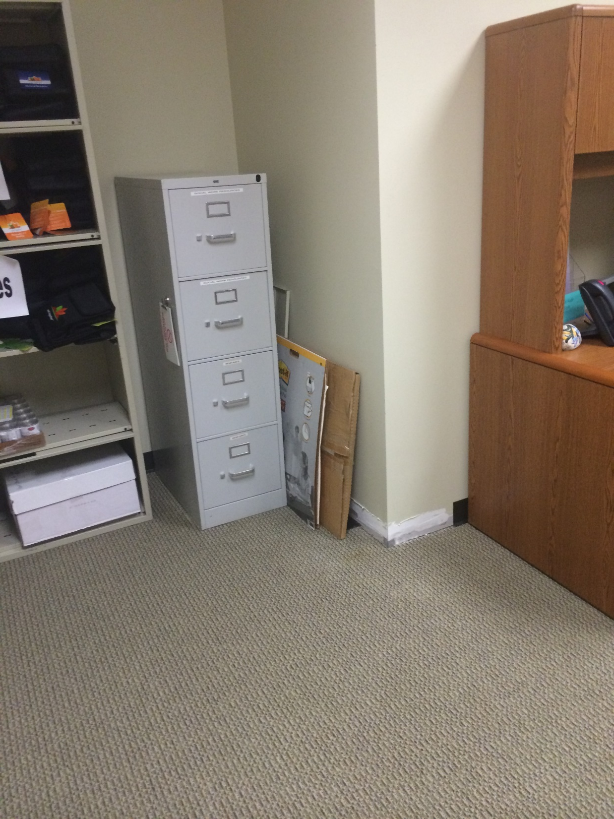

Slide 16
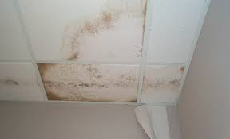

Slide 17
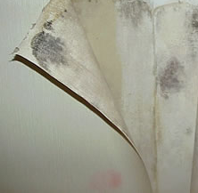

Slide 18
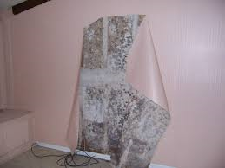

Slide 19
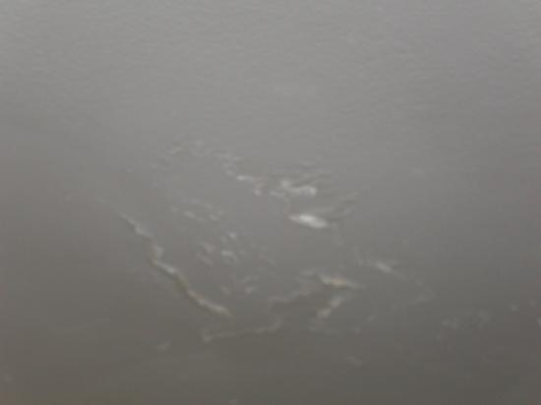

Slide 20
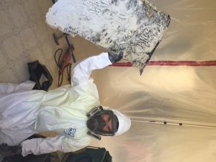

Slide 21
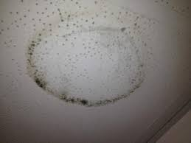

Slide 22
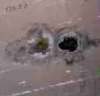

Slide 23
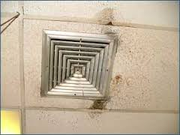

Slide 24
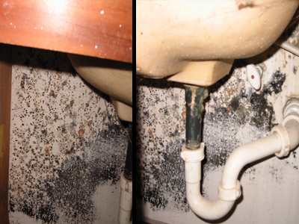

Slide 25
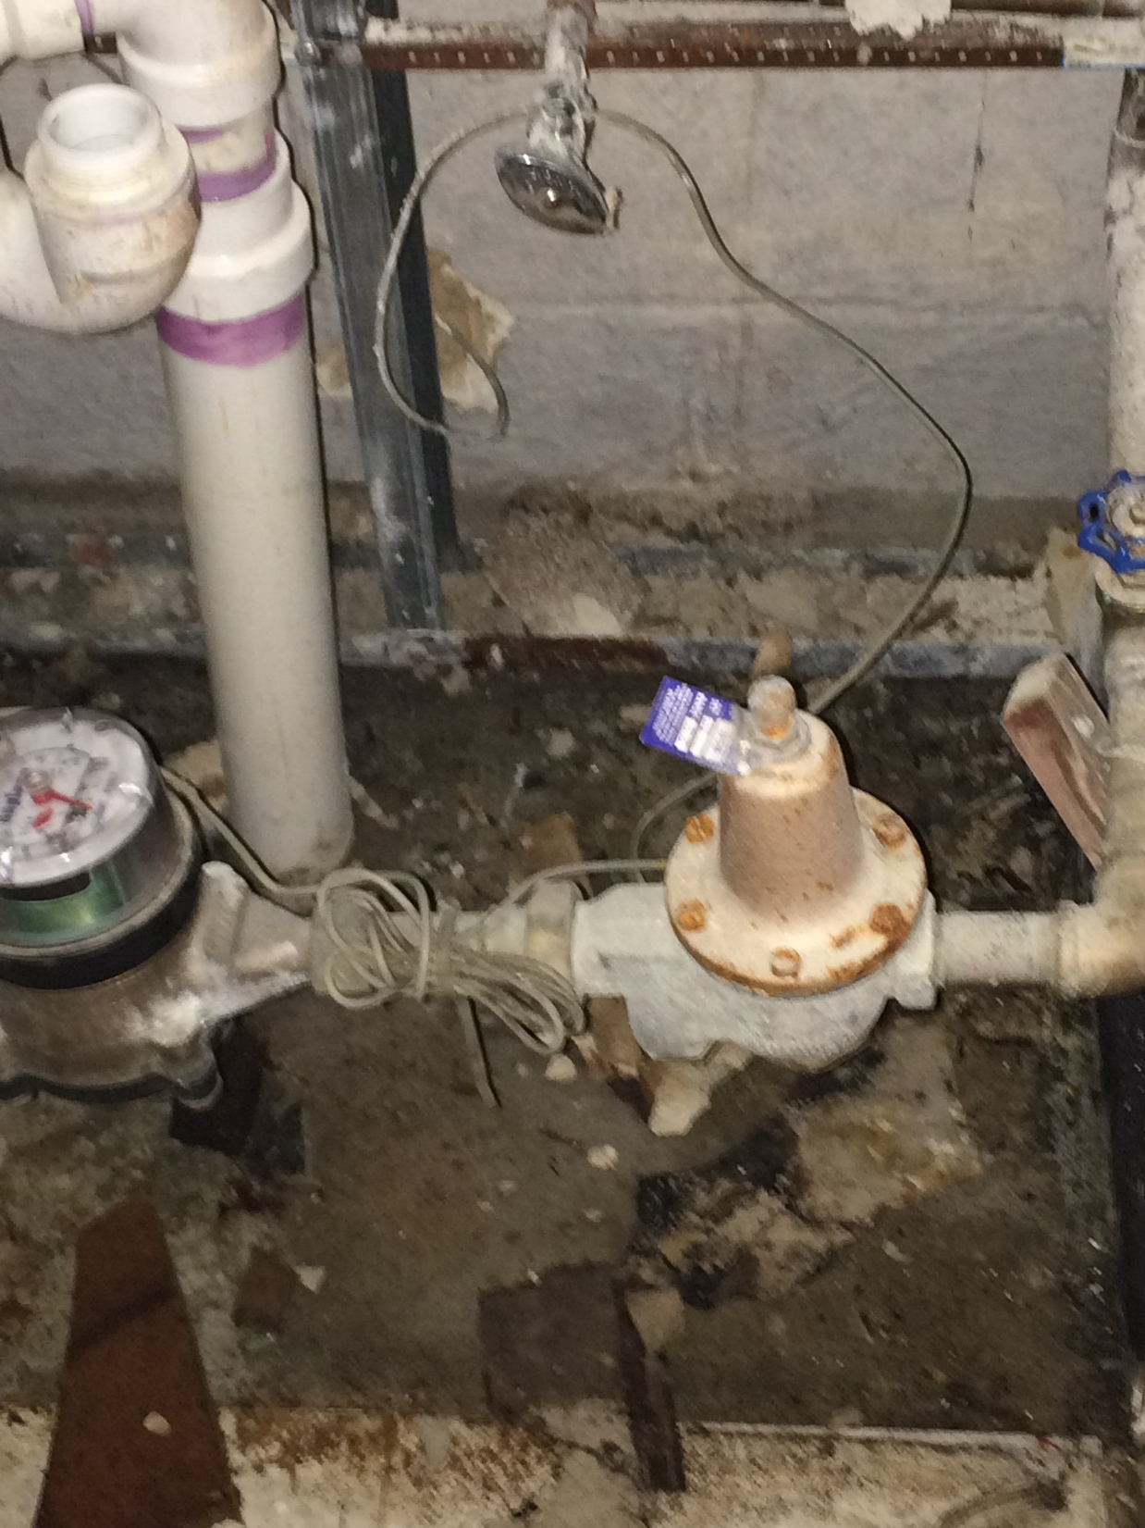

Slide 26
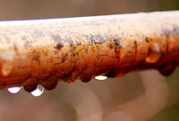

Slide 27
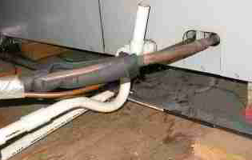

Slide 28
RISKS ASSESSMENTS SHOULD INCLUDE POTENTIAL HEALTH EFFECTS AS WELL AS SUSCETIBILITY OF PATIENTS, VISITORS, AND EMPLOYEES

Slide 29
High Risk Population
Immuno-Compromised
Underlying Illnesses
Burn victims
Critical Care Units
Respiratory Illnesses
Immuno-suppressant drugs
Very young
Very elderly
Atopic individuals

Slide 30
Potential Contaminants
Bacteria inherent to water damaged building materials
  Various gram negative bacteria
  Pseudomonas
  Klebsiella
  Bacillus (Non-anthracis)
  Staphylococcus
  Micrococcus
  Endotoxins
Fungi
  Aspergillus
  Penicillium
  Stachybotrys
  Chaetomium
  Aureobasidium
  Mycotoxins
  Cell fragments
  Gluans

Slide 31
Potential Health Effects
Allergenic
Pathogenic
Toxigenic
Irritant
Exacerbation and Causation of Asthma
Inflammatory Responses

Slide 32
ADVERSE HEALTH EFFECTS CAN OCCUR WHETHER THE MICROORGANISMS ARE
DEAD OR ALIVE

Slide 33
Water Damage Response
LOCATE AND STOP THE SOURCE OF WATER
ISOLATE THE AFFECTED AREA
  HVAC System
  Containment Barriers
  HEPA filtered negative air (ventilation balancing might be an option); Quick check with string, smoke stick)
INVESTIGATE FOR HIDDEN HAZARDS
  Asbestos
  Electrical
  Hidden mold
  Equipment in the ceiling
Identify boundaries of water damage
  Surface moisture meter
  Infrared camera

Slide 34
Mitigation
Extract Water
Remove water damaged contents
  Documents put in clear bags for sorting elsewhere
  Category 1 water - possible to put in freezers then contract for freeze drying
  Discard porous furnishings
  Drying chamber for semi-porous (category 1 only)
Drying
  Set up dehumidifiers
  Set up HEPA-filtered air cleaners
  No air movers unless the water is category 1 and containment is in place
  Monitor drying with hygrometer and surface moisture meters – document daily
Remove porous building materials (within 24 hours)
  Mist with sanitizing agent prior to removal
  Carpeting and pad (unless category 1)
  Drywall
  Insulation
Final Detail Cleaning
  HEPA Vacuum
  Damp wipe with sanitizer/disinfectant
  Terminal clean patient care areas, surgery, critical care areas

Slide 35
Who Does The Work
In-House
Professional Restoration Contractor
Stop Water Source
Isolate Area
  Containment barriers
  HVAC system
Extract Water
Set up Dehumidifiers
Relocate Contents
Removal of Water Damaged Building Materials
  Must be trained
  Must have hazard communication training specific to mold/water damage contaminants
  Must Wear PPE
  Engineering Controls in Place
Maintenance Staff not trained
Large Losses
Asbestos Present in Wet Area
Pre-existing mold
Document Restoration
High Risk Areas

Slide 36
Terminology
Sanitizers
  Products use to reduce, but not necessarily eliminate microorganisms from inanimate surfaces
Disinfectants
  Products that kill or inactivate at least 99.9% of disease producing microorganisms on inanimate surfaces. Used t destroy or irreversibly inactivate infectious fungi and bacteria, but not necessarily their spores
Sterilizers (sporicides)
  Products used to destroy or eliminate all forms of microbial life, including fungi, viruses, and all forms oaf bacteria and their spores
Growth Inhibitors (Bacteriostats, Fungistats)
  Products used to treat surfaces or be incorporated into materials to suppress or retard future vegetative growth under moist conditions

Slide 37
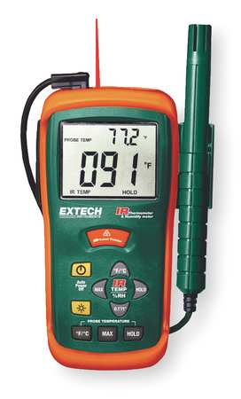
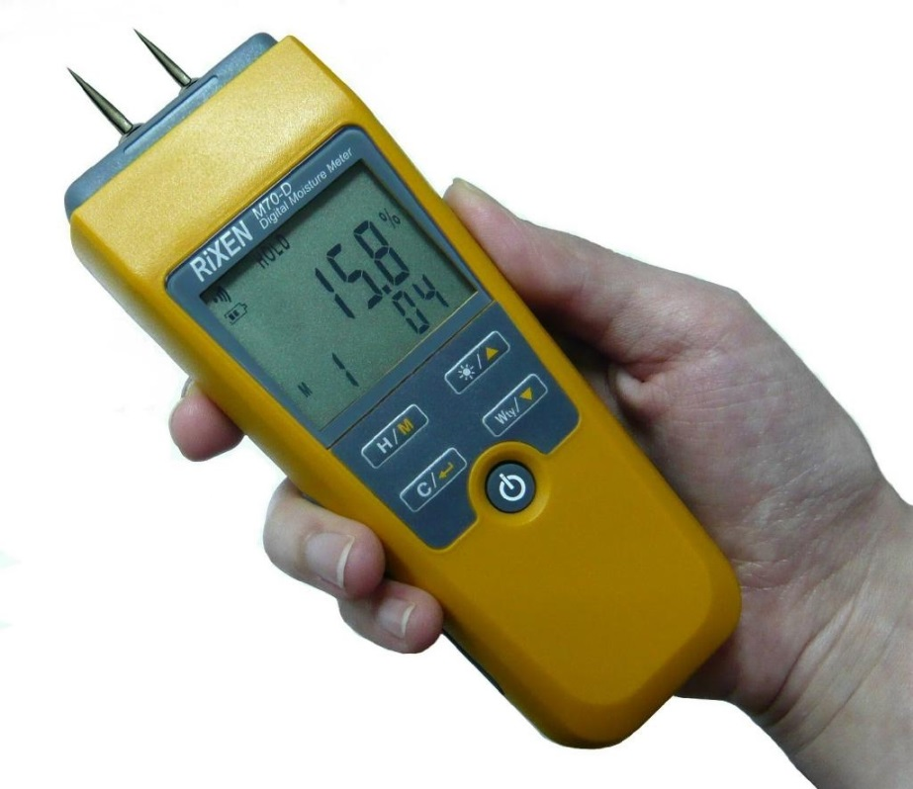

Slide 38
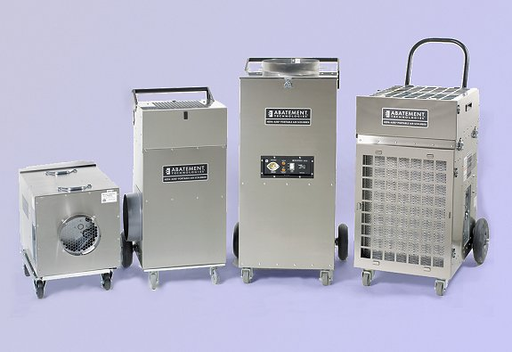

Slide 39
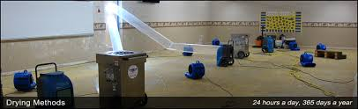

Slide 40
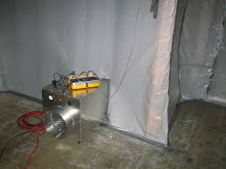

Slide 41
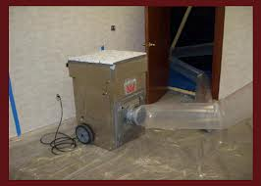

Slide 42
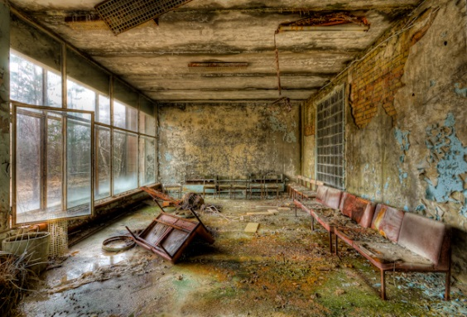

Slide 43
Microbial Sampling
Testing Should Only Be Conducted To Answer A Question That Cannot Otherwise Be Answered
  Testing not necessary to know that restoration or remediation is required. If you visibly see damage, you know it is necessary.
  If a physician asks for testing to determine the types of microorganisms are present, testing would be indicated.
If Testing is conducted, a well designed sampling plan must be developed to answer the question.
  Replicates
  Multiple Sample Methods
    Air Samples
      Culturable
      Countable
      Mold Specific Polymerase Chain Reaction
    Surface samples
    Dust Samples

Slide 44
How Do You Know The
Job IS Complete
No moisture
Surfaces are dry
Relative Humidity is less than 40%
No stains on building materials
No odors that would be consistent with volatile organic compounds from microbial growth
Work area and adjacent areas are free of particulates and dust
Verified that containment and engineering controls were used appropriately

Slide 45
Quality Control
In House
Hired Contractors
Policies and Procedures for addressing water damage
Equipment cleaning and maintenance program
Frequent inspections during drying and restoration process
Vet contractors in advance
  Referrals
  Inspect facility
  Ask for copy of SOP’s
  What standards do they follow
  Knowledge and experience with Healthcare Infection Control Construction Policies
  Obtain a MOU

Slide 46
Thank You

Slide 47
References
Institute of Inspection, Cleaning, and Restoration Certification, IICRC S500, Standard and Reference Guide for Professional Mold Remediation, 3rd edition, 2006. iicrc.org
APIC State-of-the-Art Report: The role of infection control during construction in Health care facilities, AJIC AM J. Infect Control 2000; 28:156-69
World Health Organization, Dampness and Mold, 2009
http://www.euro.who.int/__data/assets/pdf_file/0017/43325/E92645.pdf

