Slide 1
MHCSA Presentation
June 15, 2018, 12 Noon to 1pm Eastern
MIOSHA Update for Inpatient Healthcare Settings
Barton G. Pickelman, CIH, Director, MOSHA
Phone: 1-415-655-0001
Meeting No: 640 547 120 #
The meeting numbers are DIFFERENT for the conference call and presentation.
See your e-mail invite for the link to view the presentation.
This information is intended to provide general guidelines for educational purposes. It is not intended and should not be construed as legal or medical advice. The viewpoints expressed are those of the speaker and are not necessarily views endorsed by the Michigan Health Care Safety Association.

Slide 2
MIOSHA Update for Inpatient Healthcare Settings
Presented by
Barton G. Pickelman, CIH
MIOSHA Director

Slide 3
Agenda
MIOSHA Strategic Plan
Injury and Illness Rates
Reasons for Compliance Inspection
Citation and Appeals Process
Frequently Cited Serious Violations
Resources

Slide 4
MIOSHA Strategic Goals FY 2014-2018: Reduce by 15% the rate of worker injuries and illnesses in high-hazard industries:
Approach:
High-hazard industries (I&I rates above Michigan average)
Focus attention and resources on greatest hazards
“Educate Before We Regulate”

Slide 5
MIOSHA Strategic Goals FY 2014-2018 High Hazard Industries:
Beverage and Tobacco Product Mfg.
Primary Metal Mfg.
Fabricated and Metal Product Mfg.
Machinery Mfg.
Warehousing and Storage
Nursing and Residential Care Facilities
Hospitals
Accommodations
Transportation Equipment Mfg.
Support Activities for Transportation
Notes:
Instructor’s notes: Describe the high hazard Industries.
Beverage and Tobacco Product Mfg.(312)
Wood Products Mfg.(321)
Plastics and Rubber Products Mfg.(326)
Non-Metallic Mineral Product Mfg.(327)
Primary Metal Mfg.(331)
Fabricated Metal Product Mfg.(332)
Machinery Mfg.(333)
Transportation Equipment Mfg.(336)
Recyclable Material Merchant Wholesalers(423930)
Merchant Wholesalers-Non Durable Goods(424)
Landscaping Services(561730)
Hospitals(622)
Nursing and Residential Care Facilities(623)
Construction(23)

Slide 6
Michigan 2016 Nonfatal Occupational Injuries and Illnesses Incidence Rates (per 100 Full-time Workers)
 | Total Recordable Cases | Cases with Days Away, Transfer or Restriction | Other Recordable Cases
All Industries (Private Sector) | 3.3 | 1.6 | 1.7
Hospitals | 6.6 | 2.4 | 4.2
Hospitals for 2014 | 7.0 | 2.8 | 4.8
Notes:
Compare the 2016 rates with the 2014 rates. There has been some improvement since 2014.
Total recordable case rate in 2012 was 7.5. Moving slowly but going the right direction.

Slide 7
Notes:
Michigan statistics - Red circle around the total I & I cases in Healthcare for 2016.

Slide 8
Causes of Injury and Illness in Education and Health Services – By Event or Exposure
Bureau of Labor Statistics: 2016 Nonfatal injuries and illnesses involving days away from work - Education and Health Services
Notes:
National data: Total number of nonfatal injuries and illnesses (Days Away) 2016 by EVENT OR EXPOSURE:
Education and Health Services – Total – 166,530
Violence and other injuries by persons or animals = 22,190
Intentional by person = 12,750 (11,810 hitting, kicking, beating, shoving)
Unintentional by person = 8,080 (4,040 occurred while restraining/subduing or while moving)
Transportation incidents = 7,810
Falls, Slips, Trips = 43,660
Exposure to harmful substances or environments = 6,100
Contact with objects and equipment = 21,110
Overexertion and bodily reaction = 65,160
Other = 490
Nonfatal of injury or illness by SOURCE
Education and Health Services = 166,530
Chemicals and chemical products = 2100
Containers, furniture and fixtures = 16,640 (Containers = boxes, crates, cartons, pots, pans, trays, cans; Furniture = beds and chairs)
Machinery = 3020 (0ver 1/3 incidents from heating, cooling and cleaning machinery also includes are Food/beverage and medical surgical and x-ray machinery)
Parts and materials = 2,280 (building materials include solid building materials, fasteners, wire)
Persons, plants, animals, and minerals = 80,650 (21,310 source is the injured or ill worker; 56,040 other than injured or ill worker of those 56,040 there were 43,520 listed as “patients” and 8,090 listed as “other client or customer”)
Structures and surfaces = 37,420 (33,340 = floors, walkways, ground surfaces)
Tools, instruments, and equipment = 9,870 (6180 medical and surgical instruments and equipment)
Vehicles = 11,170 (8020 highway vehicles; 2430 nonpowered plant and industrial vehicles like carts and dolly, hand truck)
Other sources = 2600

Slide 9
Hazards in Healthcare
Safe Patient Handling (Musculoskeletal disorders)
Workplace Violence
Infectious Diseases
Chemical Hazards:
Ethylene Oxide
Formaldehyde
Glutaraldehyde
Hazardous Drugs
Waste Anesthetic Gases
Emergency Response Hazards
Chemical
Biological
Physical
Radioactive
Radiation
Ionizing
Non-ionizing
Latex Allergies
Notes:
From Federal OSHA eTool for Healthcare: https://www.osha.gov/SLTC/healthcarefacilities/index.html
Emergency response hazards: During the provision of emergency response care, healthcare workers may be exposed to chemical, biological, physical, or radioactive hazards. These hazards could be encountered singly or in combination with other hazards, could be a hazard that has never been or is rarely seen by the healthcare provider (e.g., anthrax), and could involve a large number of affected individuals that stresses available resources.

Slide 10
2017 Top 25 Cited Rules for NAICS 622, Hospitals, are found in the following:
Michigan Occupational Safety and Health Act (MIOSHA) P.A. 154 of 1974
Occupational Health
Part 305 Asbestos in General Industry
Part 306 Formaldehyde
Part 430 Hazard Communication
Part 433 Personal Protective Equipment
Part 451 Respiratory Protection
Part 472 Medical Services and First Aid
Part 554 Bloodborne Infectious Diseases
Occupational Safety
Part 1 General Provisions
Part 21 Powered Industrial Trucks
Part 33 Personal Protective Equipment
Part 40 Safety-Related Work Practices
The Top 25 cited rules in this presentation do not include those classified as “other-than-serious”
Notes:
These standards are listed in numeric order by part # not in order of frequency or severity of the citation.
The top 25 cited rules fall under Act 154 or the standards listed on this slide.
The Top 25 does not include “other-than-serious”. All the rules listed in this presentation were cited as “serious” or higher.

Slide 11
Michigan Occupational Safety and Health Act 154 of 1974
General Duty Clause:
“Employers shall furnish to each employee, employment and a place of employment that is free from recognized hazards that are causing, or are likely to cause, death or serious physical harm to the employee.”
Examples of conditions cited under the General Duty Clause:
Tuberculosis
Workplace Violence
Ergonomics related injuries and illnesses
Notes:
When determining if citations will be issued for Workplace Violence and Ergonomics citations, compliance officers may use information on the 300 log and incident rates to determine if the healthcare facility has a higher rate of incidents than the national average.
This is not the only factor used to determine if citations will be issued under the General Duty Clause but recommended that healthcare facilities track this.

Slide 12
Reasons For a MIOSHA Inspection
Imminent danger
Fatality / Catastrophic
Accident investigations
Employee complaints
Program Initiated Routine safety / health inspections
Visual Activity or Dodge reports (construction)
Referrals (media, government agencies, or physician)
Follow-ups (re-inspections)
Notes:
8 Reasons for a MIOSHA inspection from the MIOSHA FOM 1-20-06
Imminent danger
(Section 5(3) of the Act 154 of 1974 )A condition or practice in a place of employment which is such that a danger exists which could reasonably be expected to cause death or serious physical harm, either immediately or before the imminence of the danger can be eliminated through the enforcement procedures otherwise provided.
Fatality / Catastrophic
These include reports of fatalities and catastrophes received by MIOSHA.
Accident investigations
Additional inspections of employers at multi-employer or single-employer worksites whose activities were not included in the programmed assignment. This includes non-fatal and non catastrophic accidents.
Employee complaints (This is the most common reason for a health inspection)
These include reports of an alleged hazard (over which MIOSHA has jurisdiction) or a violation of the Act given by a current employee, a representative of employees, a Sec. 65(1) investigator seeking resolution of a discrimination complaint, or an individual with knowledge of the workplace, such as the employee of a contractor working on-site. In some circumstances, a complaint may be accepted from a former employee, for example, a complaint is filed simultaneous or shortly after employment ends (generally within 30 days) or where the employee may have been discriminatorily discharged for a complaint about unsafe or unhealthful conditions in the workplace. Reports of unsafe or unhealthy working conditions received from any other individuals alleging to be knowledgeable of the situation, may be treated as either a complaint or a referral depending on the seriousness of the allegations, level of detail provided, and other factors deemed appropriate.
Routine safety / health inspections (Stress to class this is the most common reason for a safety inspection)
Inspections of worksites which have been scheduled based upon objective or random selection criteria are programmed. The worksites may be selected by state scheduling plans, special emphasis programs, or strategic plan-related criteria Referrals These include reports received by MIOSHA of an alleged hazard or a violation of the Act given by any source not considered a complainant. These include media reports; referrals from local, state, or federal agencies; and health care providers.

Slide 13
What Happens During MIOSHA Compliance Inspection
Notes:
How long will a compliance officer wait until the hospital safety officer can travel to the site? Hours? Days?

Slide 14
Arrival At Site
No advanced notice
Ask for an employer representative
Ask for employee representative (if applicable)
Present credentials and business card
Explain reason for visit
Relate need for opening conference
Notes:
How long will a compliance officer wait until the hospital safety officer can travel to the site? Hours? Days?

Slide 15
Opening Conference
Explain employer’s and employee’s rights including discrimination protection
Select person(s) of choice to accompany MIOSHA compliance officer during visit (Employer and Employee if applicable)
Receive copy of written complaint (if applicable)
Conduct inspection w/o unreasonable delay

Slide 16
Inspection Process
Site Walk Around
Confidential Employee Interviews
Required postings and records (training, equipment)
MIOSHA inspector may deny the right of accompaniment to any person whose conduct interferes with a full and orderly inspection
Take notes/photos of alleged violations
The investigation will focus on primary complaint, accident, or referral but can't ignore serious violations not related to the investigation (Plain View)
Notes:
Opening Conference cont.
Samples and documentation
Personal air or noise monitoring or area monitoring for hazardous air contaminants (8 hr. shift)
Visual documentation (camera)
Take notes, no copies left with employer
Walk Around
Areas, process or equipment to be covered
Systematic orderly inspection
Size of plant square footage to inspect
Employee Interviews
To confirm training
Associated with incident
Violation documentation

Slide 17
Multiple Onsite Visits
Additional visits might be required for health hazards – air or noise monitoring based on walk around.
Monitoring must represent normal working conditions and/or worst case scenario.
Both normally require full shift sampling.
Employer allowed to do parallel monitoring.
Notes:
Air monitoring strategies developed during initial walk around, based on management information, chemical information in SDS’s, IH observations and employee interviews.
Air or noise monitoring done on 3-5 employees or more depending on worksite conditions and number of employees exposed.
Ergonomic evaluations may require in-depth records reviews, employee interviews and videotaping of relevant work operations. Air monitoring for one or more hazardous air contaminants.
Noise monitoring.
Monitoring must represent normal working conditions and/or worst case scenario.
Both normally require full shift sampling.
Employer allowed to do parallel monitoring.
Ergonomic evaluations.

Slide 18
Closing Conference
Discuss each “alleged” violation
Discuss abatement period and suggested methods
Review appeal rights and Penalty Reduction Agreement
Penalty calculation done by MIOSHA management not by the compliance officer.
Penalty reductions applied, if applicable

Slide 19
Penalty Reduction Factors
Size of business
Up to 80%
Past history (three years)
10%
Good faith
Up to 30%
Notes:
Traditional penalty reductions
New formula for size of business
Past history
Good faith
Penalty Adjustment Factors. The GBP may be reduced by as much as 95 percent depending upon the employer's "good faith," "size of business," and "history of previous violations." A maximum of 80 percent reduction is permitted for size, 30 percent for good faith, and 10 percent for history
GBP=gravity based penalty

Slide 20
Formula for Size Reduction
EMPLOYEES | PERCENT REDUCTION
1-10 (worldwide) | 80%
1-25 (site specific) | 60%
26-100 (site specific) | 40%
101-250 (site specific) | 20%
251 or more (site specific) | None

Slide 21
Past History with MIOSHA
An employer receives a 10% adjustment on assessed penalties where there have been no “serious,” “repeat,” or “willful” violations during the past 3 years.
Notes:
History Reduction.
A reduction of 10 percent shall be given to Employers who have not been
cited by MIOSHA for any serious, willful, or repeat violations within the
past five years for GI and three years CSHD.
This three-year/five-year window of exposure starts with the
case closing date of the prior inspection and ends with the closing
conference date of the current inspection.

Slide 22
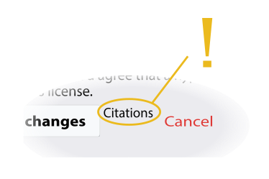
Types of Violations
Violation classification
Other Than Serious
Serious
Failure to abate
Repeat
Willful
Notes:
Image free use: https://commons.wikimedia.org/wiki/File:Citations_button.svg

Slide 23
Other Than Serious
The resulting injury would probably not result in death or serious physical injury but would have a direct or immediate relationship to the safety and health of employees.

Slide 24
Serious
A hazardous condition violating a standard or rule exists that has a substantial probability of causing serious physical harm or death to workers.
Notes:
Serious Violations. A serious violation is deemed to exist in a place of employment if there is a substantial probability that death or serious physical harm could result from a condition which exists, or from one or more practices, means, methods, opera­tions, or processes which have been adopted or are in use, in such place of employment unless the employ­er did not, and could not with the exercise of reasonable diligence, know of the presence of the violation.
MICHIGAN OCCUPATIONAL SAFETY AND HEALTH ACT (EXCERPT) Act 154 of 1974
408.1006 Definitions; P to W. [M.S.A. 17.50(6)]
Sec. 6. (4) “Serious violation” means a violation of this act, an order issued pursuant to this act, or a rule or standard promulgated under this act or adopted by reference pursuant to this act for which a substantial probability exists that death or serious physical harm could result from the violation or from a practice, means, method, operation, or process which is in use, unless the employer did not and could not, with the exercise of reasonable diligence, know of the presence of the violation.

Slide 25
Failure to Abate
A violation which appears on a citation previously issued to an employer that has become a final order and has not been corrected.
Notes:
Failure to Abate Notification
A failure to abate exists when the employer has never corrected a violation for which a citation has been issued and the abatement date has passed or which is covered under a settlement agreement, or has not complied with interim measures involved in a long-term abatement within the time given.

Slide 26
Repeat
A violation which was cited on a previous inspection (five year limitation) and the same rule is violated again.
It does not have to be the same machine or location to be a repeat.
Notes:
Repeat Violations
An employer may be cited for a repeat violation if that employer has been cited previously for a substantially similar condition.
(Note: “Repeat” is used together with the appropriate violation classification. For example, a violation may be classified “Repeat, Other-than-Serious; or Repeat: Serious; etc...”)

Slide 27
Willful
A hazardous condition exists where the evidence shows either an intentional disregard of the Act or plain indifference to its requirements by the employers
May be any member of supervision or management

Slide 28
What to do when the citation arrives?
Abate or fix the violative conditions
(eliminate or control the hazard)
Ask for a Penalty Reduction Agreement (PRA)
Appeal violations, penalty, or abatement date
Post copy of citation for three days or longer for employees to read or until item is abated.
Notes:
Instructor Note: Read the slide title and ask for a response from the group (What to do when the citation arrives?)
Citations are sent certified mail to the employer. Normally to the chief in-plant executive
A copy of the citation (s) must be posted upon receipt at or near the place where the violation occurred or acceptable locations for employee review such as bulletin boards
Post copy of citation for 3 days or longer for employees to read or till item is abated.

Slide 29
Appeal Options
Penalty Reduction Agreement – PRA
Appeals Process
- First Appeal
- Second Appeal
- Board of Health and Safety
- State Court of Appeals
Notes:
Instructor’s notes:
PRA – instituted by MIOSHA for reason of expediting of abatement process quickly and effective), to reduce the case load in the appeals process – also, generates incentive potential once first appeal process is initiated, then employer has from the first day through the fourteenth to agree upon a PRA)
Cannot skip order of appeal process have to go through once it is initiated step-by-step first and end, then second and end), cannot move to second appeal from the beginning
Second Appeal has ALJ
Board of Health and Safety Compliance and Appeals
State Court Level of Appeals
Free use image: https://www.freeimages.com/photo/gavel-2-1236453

Slide 30
Penalty Reduction Agreement (PRA)
Reduce the total proposed penalty by 50%
Correct all violations – provide assurance of abatement
Waive right to appeal
Pay the reduced total penalty within allotted timeframe (15 working days from MIOSHA approval of Agreement)
Done via online PRA web application
Files Ineligible for PRA’s: willful, fatality, SVEP
Advantage for MIOSHA is expedited abatement of violation/hazards
Notes:
Penalty Reduction
Abatement Dates
Not for PRA – done in an SA (settlement agreement)
Generally Within 5 Working Days
If asked those without computer accessibility can contact the division’s MIOSHA PRA Coordinator for a manual submission

Slide 31
Preparing for the Inspection
Read safety and health publications
Belong to associations
Insurance company audits
Internal self inspections
Safety committee
MIOSHA Standards knowledge
MIOSHA CET Services
Notes:
Ask the class how they can prepare for the MIOSHA Inspection and then click on the slide.
Preparing for the Inspection
Read safety publications (safety/ASSE, Metal Forming, other publications)
Belong to associations (ASSE, SE MI Safety Council Lansing Safety Council, CAM AGC)
Insurance company audits ( workers comp.)
Internal self inspections ( Safety committee, Fire inspections, CET)
Safety committee Management and employee reps
C.E.T. services ( CET on-site visits, training, hazard survey)
Standards knowledge (Which standards apply and how to read the standard)
Safety should be in the bid process
Think of safety as profit center
Free use image: https://www.freeimages.com/photo/training-room-2-1546124

Slide 32
MIOSHA Consultation Education and Training (CET) Services
Initiated by request from the employer
No cost
No citations
No monetary penalties

Slide 33
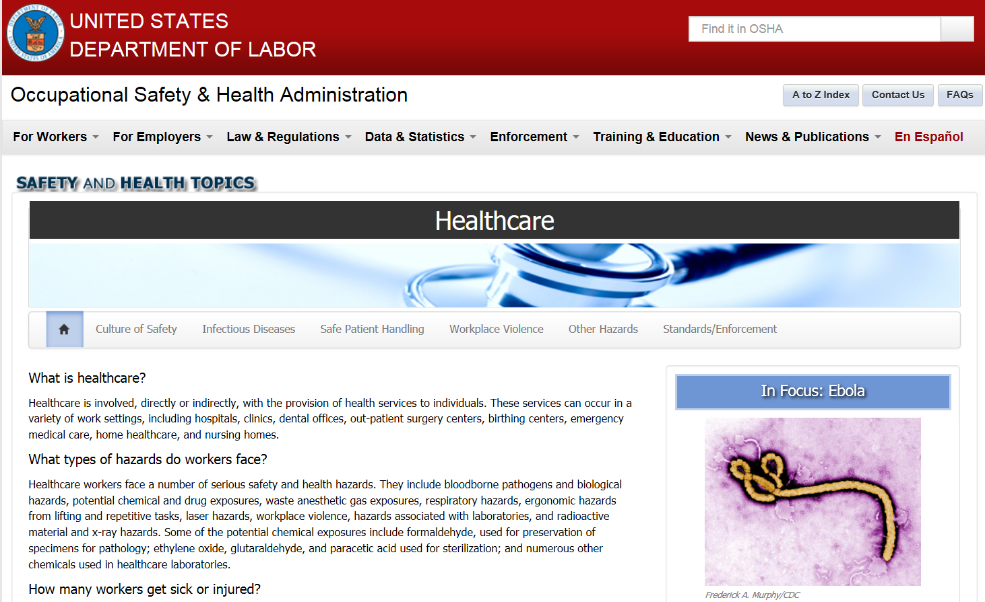
Federal OSHA Healthcare Resources
OSHA’s Healthcare Safety and Health Topics

Slide 34
Questions and Assistance
MIOSHA Consultation Education and Training
(517) 284-7720
www.michigan.gov/miosha

Slide 35
mhcsa.org
This information is intended to provide general guidelines for educational purposes. It is not intended and should not be construed as legal or medical advice. The viewpoints expressed are those of the speaker and are not necessarily views endorsed by the Michigan Health Care Safety Association.

