Slide 1
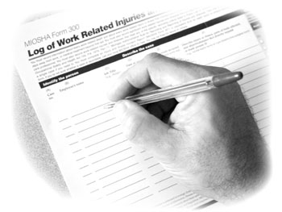
MIOSHA Recordkeeping
Part 11. Recording and Reporting Occupational Injuries and Illnesses
Presented By:
Consultation Education and Training (CET) Division
Michigan Occupational Safety and Health Administration
Michigan Department of Licensing and Regulatory Affairs
www.michigan.gov/miosha 517-284-7720

Slide 2
Objectives
Discriminate between recordable and non-recordable workplace injuries.
Discuss the purpose and criteria for completing the MIOSHA Form 300, Form 301, and Form 300 A.
Calculate incident and lost workday case rates based on the information contained within the Form 300.

Slide 3
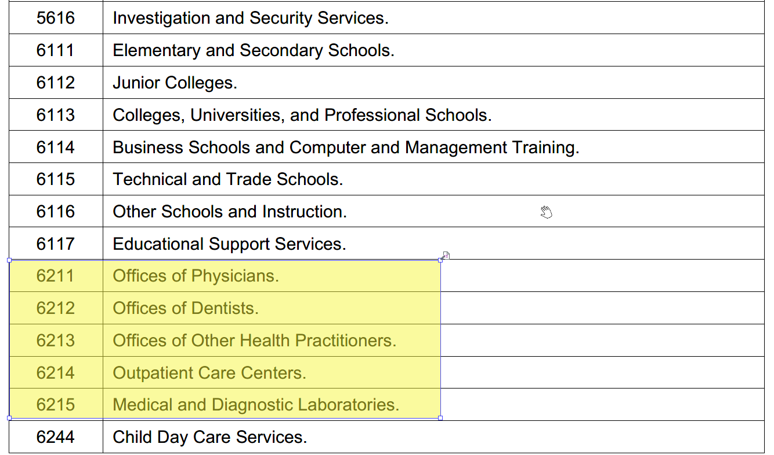
Newly included NAICS
with partial exemption
Notes:
The updated list of exempt industries and the list of newly included are available in the Overview fact sheet and the “Who has to keep records” fact sheet.
The updated list of exempt industries is also available at: http://www.osha.gov/recordkeeping/ppt1/RK1exempttable.html.
To find a list of newly exempt industries (industries that were not exempt before, but are now), view page 116 of the final rule at http://www.osha.gov/recordkeeping2014/NAICSReporting.pdf.

Slide 4
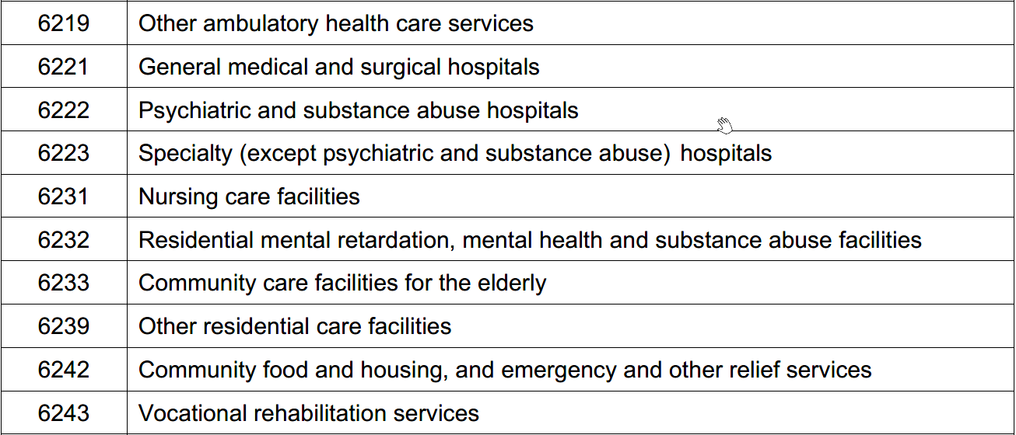

Slide 5
Definitions
"Recordable injuries and illness" means an injury or illness that meets the general recording criteria, and therefore is recordable, if it results in any of the following:
(a) Death.
(b) Days away from work.
(c) Restricted work or transfer to another job.
(d) Medical treatment beyond first-aid.
(e) Loss of consciousness.

Slide 6
Recording Criteria
All covered employers must record each fatality, injury or illness that:
Is work-related and
Is a new case and
Meets one or more of the general recording criteria contained in rules 1112 to 1119
Notes:
We will be covering Rules 1112 – 1119 in upcoming slides
R 408.22109 Recording criteria.
Rule 1109.
(1) Each employer required to keep records of fatalities, injuries, and illnesses must record each fatality, injury, and illness that involves all of the following:
(a) Is work-related.
(b) Is a new case.
(c) Meets 1 or more of the general recording criteria of R 408.22112 to R408.22112f or the application to specific cases of R 408.22113 to
R 408.22120.

Slide 7
MIOSHA-Recording Criteria

Slide 8
Determination of Work-Relatedness
Rule 1110. An injury or illness to be work-related if an event or exposure in the work environment either caused or contributed to the resulting condition or significantly aggravated a preexisting injury or illness.
Work-relatedness is presumed for injuries and illnesses resulting from events or exposures occurring in the work environment, unless an exception in R 408.22110a(5) specifically applies.
Notes:
Rule 1110. You must consider an injury or illness to be work-related if an event or exposure in the work environment either caused or contributed to the resulting condition or significantly aggravated a preexisting injury or illness. Work-relatedness is presumed for injuries and illnesses resulting from events or exposures occurring in the work environment, unless an exception in R 408.22110a(4) specifically applies.

Slide 9
EXCEPTIONS to Work- Relatedness
In the work environment as a member of the general public rather than as an employee.
Signs or symptoms surface at work but event or exposure that occurs outside the work environment.
Voluntary participation.
Result of an employee eating, drinking, or preparing food or drink for personal consumption.
Notes:
R 408.22110a(5)
(a)At the time of the injury or illness, the employee was present in the work environment as a member of the general public rather than as an employee.
(b) The injury or illness involves signs or symptoms that surface at work but result solely from a non-work-related event or exposure that occurs outside the work environment.
(c) The injury or illness results solely from voluntary participation in a wellness program or in a medical, fitness, or recreational activity such as blood donation, physical examination, flu shot, exercise class, racquetball, or baseball.
(d) The injury or illness is solely the result of an employee eating, drinking, or preparing food or drink for personal consumption whether bought on the employer's premises or brought in.
For example, if the employee is injured by choking on a sandwich while in the employer's establishment, the case would not be considered work-related.
Note: If the employee is made ill by ingesting food contaminated by workplace contaminants, such as lead, or gets food poisoning from food supplied by the employer, then the case would be considered work-related.

Slide 10
EXCEPTIONS to Work-Relatedness
Personal tasks
Personal grooming, self-medication
Motor vehicle accident while commuting
Common cold or flu
Mental Illness
Notes:
R 408.22110a(5)
(e) The injury or illness is solely the result of an employee doing personal tasks, unrelated to his or her employment, at the establishment outside of the employee's assigned working hours.
(f) The injury or illness is solely the result of personal grooming, self-medication for a non-work-related condition, or is intentionally self-inflicted.
(g) The injury or illness is caused by a motor vehicle accident and occurs on a company parking lot or company access road while the employee is commuting to or from work.
(h) The illness is the common cold or flu. Note: Contagious diseases such as tuberculosis, brucellosis, hepatitis A, or plague are considered work-related if the employee is infected at work.
(i) The illness is a mental illness. Mental illness will not be considered work-related unless the employee voluntarily provides the employer with an opinion from a physician or other licensed health care professional who has appropriate training and experience, such as a psychiatrist, psychologist, psychiatric nurse practitioner, or the like, stating that the employee has a mental illness that is work-related.

Slide 11
Parking Lots and Access Roads
ARE
Considered part of the employer’s premises.
Therefore injuries and illnesses occurring in the parking lots and access roads are considered work related and must be recorded on the establishment’s log if they meet the recording criteria.
Notes:
This is a federal interpretation, this is not written in MIOSHA’s Part 11
Exceptions: The employer may exclude from the log injuries and illnesses occurring on company parking lots and access roads while employees are commuting to or from work, running personal errands or in a motor vehicle.
Rule 1110a. (5) (g) The injury or illness is caused by a motor vehicle accident and occurs on a company parking lot or company access road while the employee is commuting to or from work.
An exemption to the exemption is if the motor vehicle accident happens in a construction work zone on a public roadway.

Slide 12
Significant Aggravation
A pre-existing injury or illness is significantly aggravated when an event or exposure in the work environment results in any of the following (which would not have occurred but for the occupational event or exposure):
Death
Loss of consciousness
Days away from work
Days of restricted or job transfer
Medical treatment
Example: Asthma aggravated by cleaning company spraying quaternary ammonium compounds near work area.
Notes:
An injury or illness is a pre existing condition if it resulted solely from a non-work-related event or exposure that occurred outside the work environment
Rule 1110b. (2) How do I know if an event or exposure in the work environment "significantly aggravated" a preexisting injury or illness? A preexisting injury or illness has been significantly aggravated, for purposes of MIOSHA injury and illness recordkeeping, when an event or exposure in the work environment results in any of the following:
(a) Death, if the preexisting injury or illness would likely not have resulted in death but for the occupational event or exposure.
(b) Loss of consciousness, provided that the preexisting injury or illness would likely not have resulted in loss of consciousness but for the occupational event or exposure.
(c) One or more days away from work, or days of restricted work, or days of job transfer that otherwise would not have occurred but for the occupational event or exposure.
(d) Medical treatment in a case where medical treatment was not needed for the injury or illness before the workplace event or exposure, or a change in medical treatment was necessitated by the workplace event or exposure.
Rule 1110b.(2) Which injuries and illnesses are considered preexisting conditions? An injury or illness is a preexisting condition if it resulted solely from a non-work-related event or exposure that occurred outside the work environment.

Slide 13
Travel Status
Work activities “in the interest of the employer.”
Home away from home.
Detour for personal reasons are not work related.
Notes:
Rule 1110b. (3) How do I decide whether an injury or illness is work-related if the employee is on travel status at the time the injury or illness occurs? Injuries and illnesses that occur while an employee is on travel status are work-related if, at the time of the injury or illness, the employee was engaged in work activities "in the interest of the employer." Examples of such activities include travel to and from customer contacts, conducting job tasks, and entertaining or being entertained to transact, discuss, or promote business. Work-related entertainment includes only entertainment activities being engaged in at the direction of the employer.
(4) Injuries or illnesses that occur when the employee is on travel status do not have to be recorded if the injuries or illnesses meet any of the following exceptions:
1110b. (a)When a traveling employee checks into a hotel, motel, or other temporary residence, he or she establishes a "home away from home." You must evaluate the employee's activities after he or she checks into the hotel, motel, or other temporary residence for his or her work-relatedness in the same manner as you evaluate the activities of a non-traveling employee. When the employee checks into the temporary residence, he or she is considered to have left the work environment. When the employee begins work each day, he or she re-enters the work environment. If the employee has established a "home away from home" and is reporting to a fixed worksite each day, you also do not consider injuries or illnesses work-related if they occur while the employee is commuting between the temporary residence and the job location.
1110b. (b) Injuries or illnesses are not considered work-related if they occur while the employee is on a personal detour from a reasonably direct route of travel, that is, has taken a side trip for personal reasons.

Slide 14
Working At Home
Cases will be considered work-related if the injury or illness occurs:
while the employee is performing work for pay or compensation,
and the injury or illness is directly related to the performance of work rather than the home environment.
Notes:
Rule 1110b. (5) How do I decide if a case is work-related when the employee is working at home? Injuries and illnesses that occur while an employee is working at home, including work in a home office, will be considered work-related if the injury or illness occurs while the employee is performing work for pay or compensation in the home, and the injury or illness is directly related to the performance of work rather than to the general home environment or setting. For example, if an employee drops a box of work documents and injures his or her foot, the case is considered work-related. If an employee's fingernail is punctured by a needle from a sewing machine used to perform garment work at home, becomes infected and requires medical treatment, the injury is considered work-related. If an employee is injured because he or she trips on the family dog while rushing to answer a work phone call, the case is not considered work-related. If an employee working at home is electrocuted because of faulty home wiring, the injury is not considered work-related.

Slide 15
New Case
You must consider an injury or illness to be a “new case” if any of the following apply:
The employee has not previously experienced a recordable injury or illness of the same type that affects the same part of body;
or
The employee previously experienced a recordable injury or illness of the same type that affects the same part of body but had recovered completely and an event or exposure in the work environment caused the signs and symptoms to reappear.
Notes:
R408.22111 Determination of new cases.
Rule 1111. (1) Basic requirement. You must consider an injury or illness to be a "new case" if either of the following applies:
(a) The employee has not previously experienced a recorded injury or illness of the same type that affects the same part of the body.
(b) The employee previously experienced a recorded injury or illness of the same type that affected the same part of the body but had recovered completely (all signs and symptoms had disappeared) from the previous injury or illness and an event or exposure in the work environment caused the signs or symptoms to reappear.

Slide 16
General Recording Criteria
An injury or illness is recordable if it results in one or more of the following:
Death
Days away from work
Restricted work or transfer to another job
Medical treatment beyond first aid
Loss of consciousness
Significant injury or illness diagnosed by a physician or other Licensed Health Care Professional (LHCP)
Notes:
These are all going to be discussed in the next few slides.
R 408.22112 Basic requirement
Rule 1112. (1) You must consider an injury or illness to meet the general recording criteria, and therefore to be recordable, if it results in any of the following:
(a) Death.
(b) Days away from work.
(c) Restricted work or transfer to another job.
(d) Medical treatment beyond first aid.
(e) Loss of consciousness.
(2)You must also consider a case to meet the general recording criteria if it involves a significant injury or illness diagnosed by a physician or other licensed health care professional, even if it does not result in death, days away from work, restricted work or job transfer, medical treatment beyond first aid, or loss of consciousness.

Slide 17
Days Away From Work
Begin Counting Day After Injury
Calculated on Calendar Days
180 Day Cap
Notes:
Rule 1112b. (2) Do I count the day on which the injury occurred or the illness began? No. You begin counting days away on the day after the injury occurred or the illness began.
Rule 1112 b (1) How do I record a work-related injury or illness that results in days away from work? When an injury or illness involves 1 or more days away from work, you must record the injury or illness on the MIOSHA 300 log with a check mark in the space for cases involving days away and an entry of the number of calendar days away from work in the number of days column. If the employee is out for an extended period of time, you must enter an estimate of the days that the employee will be away, and update the day count when the actual number of days is known.
Rule 1112 b (8) Is there a limit to the number of days away from work I must count? Yes, you may "cap" the total days away at 180 calendar days. You are not required to keep track of the number of calendar days away from work if the injury or illness resulted in more than 180 calendar days away from work or days of job transfer or restriction, or both. In such a case, entering 180 in the total days away column will be considered adequate.
If a licensed health care professional recommends that the worker stay at home but the employee comes to work anyway, you must record these on the Log.
If the licensed health care professional recommends that the worker return to work but the employee stays at home anyway, you must end the days away from work.
Weekends, holidays, vacation days or other days off are included in the total number of days.
There are more examples on page 11 of the standard.

Slide 18
Restricted Work Activity
An employee is unable to perform all routine job tasks or cannot work for a complete day.
A physician or LHCP recommends that the employee not perform one or more of the routine functions of the job.
“Routine Functions” work activities the employee regularly performs at least once per week.
Notes:
Rule 1112c. (1) How do I record a work-related injury or illness that results in restricted work or job transfer?
When an injury or illness involves restricted work or job transfer but does not involve death or days away from work, you must record the injury or illness on the MIOSHA 300 Log by placing a check mark in the space for job transfer or restriction and an entry of the number of restricted or transferred days in the restricted workdays column.
(2) How do I decide if the injury or illness resulted in restricted work?
Restricted work occurs when, as the result of a work-related injury or illness, either of the following occurs:
(a) You keep the employee from performing 1 or more of the routine functions of his or her job, or from working the full workday that he or she would otherwise have been scheduled to work.
(b) A physician or other licensed health care professional recommends that the employee not perform 1 or more of the routine functions of his or her job, or not work the full workday that he or she would otherwise have been scheduled to work.
Rule 1112c. (3) What is meant by “routine functions”? For recordkeeping purposes, an employee’s routine functions are those work activities the employee regularly performs at least once per week.
Page 13 of standard
Rule 1112c. (12) How do I count days of job transfer or restriction? You count days of job transfer or restriction in the same way you count days away from work, using R 408.22112b (2) to (9). The only difference is that, if you permanently assign the injured or ill employee to a job that has been modified or permanently changed in a manner that eliminates the routine functions the employee was restricted from performing, you may stop the day count when the modification or change is made permanent. You must count at least 1 day of restricted work or job transfer for such cases.

Slide 19
Transfer to Another Job
An employee is assigned to a job other than his/her regular job for part of the day.
Employee permanently assigned to a job that has been modified or permanently eliminates the routine functions. At least one day must be reported on the Log 300.
Notes:
Rule 1112c (10) How do I decide if an injury or illness involved a transfer to another job?
If you assign an injured or ill employee to a job other than his or her regular job for part of the day, the case involves transfer to another job. Note: This does not include the day on which the injury or illness occurred.
(11) Are transfers to another job recorded in the same way as restricted work cases?
Yes. Both job transfer and restricted work cases are recorded in the same box on the MIOSHA 300 Log. For example, if you assign, or a physician or other licensed health care professional recommends that you assign, an injured or ill worker to his or her routine job duties for part of the day and to another job for the rest of the day, the injury or illness involves a job transfer. You must record an injury or illness that involves a job transfer by placing a check in the box for job transfer.
Page 13 of standard
Rule 1112c. (12) How do I count days of job transfer or restriction? You count days of job transfer or restriction in the same way you count days away from work, using R 408.22112b (2) to (9). The only difference is that, if you permanently assign the injured or ill employee to a job that has been modified or permanently changed in a manner that eliminates the routine functions the employee was restricted from performing, you may stop the day count when the modification or change is made permanent. You must count at least 1 day of restricted work or job transfer for such cases.

Slide 20
Medical Treatment
"Medical treatment" means the management and care of a patient to combat disease or disorder. For the purposes of these rules, medical treatment does not include any of the following:
Observation or counseling
Diagnostic purposes
First-aid
Notes:
Reference the MIOSHA Recordkeeping General Guide For Recording handout
Rule 1112d. (2)What is the definition of medical treatment? "Medical treatment" means the management and care of a patient to combat disease or disorder. For the purposes of these rules, medical treatment does not include any of the following:
(a) Visits to a physician or other licensed health care professional solely for observation or counseling.
(b) The conduct of diagnostic procedures, such as x-rays and blood tests, including the administration of prescription medications used solely for diagnostic purposes, such as eye drops to dilate pupils.
(c) "First aid" as defined in sub rule (3) of this rule.

Slide 21
First Aid Treatment
Nonprescription medication at nonprescription strength
Administering tetanus immunizations
Cleaning, flushing, or soaking wounds
Bandages, Band-Aids, gauze pads, butterfly bandages or steri-strips
Using hot or cold therapy
Nonrigid means of support
Temporary immobilization devices
Notes:
Rule 1112d. (3) (a) – (n) (a) Using a nonprescription medication at nonprescription strength. For medications available in both prescription and nonprescription form, a recommendation by a physician or other licensed health care professional to use a nonprescription medication at prescription strength is considered medical treatment for recordkeeping purposes.
(b) Administering tetanus immunizations. Administering other immunizations, such as hepatitis B vaccine or rabies vaccine, is considered medical treatment.
(c) Cleaning, flushing, or soaking wounds on the surface of the skin.
(d) Using wound coverings such as bandages, Band-aidsTM, gauze pads, or the like; or using butterfly bandages or Steri-stripsTM. Using other wound closing devices, such as sutures, staples, or the like, is considered medical treatment.
(e) Using hot or cold therapy. (f) Using any nonrigid means of support, such as elastic bandages, wraps, nonrigid back belts, or the like. Using devices that have rigid stays or other systems designed to immobilize parts of the body is considered medical treatment for recordkeeping purposes.
(g) Using temporary immobilization devices while transporting an accident victim, such as splints, slings, neck collars, back boards, and the like.
Reference the MIOSHA Recordkeeping General Guide For Recording handout provided to students.

Slide 22
First Aid Treatment
Drilling of a fingernail or toenail to relieve pressure, or drain fluid from a blister.
Eye patches.
Removing foreign bodies from eye using only irrigation or a cotton swab.
Removing splinters or foreign material from areas other than the eye by irrigation, tweezers, cotton swabs, or other simple means.
Finger guards.
Massages.
Drinking fluids for relief of heat stress.
Notes:
1112d. (3) (a) – (m) (h) Drilling of a fingernail or toenail to relieve pressure, or draining fluid from a blister.
(i) Using eye patches.
(j) Removing foreign bodies from the eye using only irrigation or a cotton swab.
(k) Removing splinters or foreign material from areas other than the eye by irrigation, tweezers, cotton swabs, or other simple means.
(l) Using finger guards.
(m) Using massages. Physical therapy or chiropractic treatment is considered medical treatment for recordkeeping purposes.
(n) Drinking fluids for relief of heat stress.

Slide 23
Loss of Consciousness
Must be recorded regardless of treatment or lack of treatment.
If not treated, then record as “other recordable.”
Notes:
Rule 1112e. Is every work-related injury or illness case involving a loss of consciousness recordable? Yes, you must record a work-related injury or illness if the worker becomes unconscious, regardless of the length of time the employee remains unconscious
Administration of Oxygen. If oxygen is given (administered) does it make a case recordable?
Yes, if the employee exhibits symptoms of a work related injury or illness the administration of oxygen makes the case recordable, even when no further medical treatment is provided. The administration of oxygen is considered medical treatment for MIOSHA injury and illness recordkeeping purposes.

Slide 24
Significant Diagnosed Injury/Illness
Cancer
Chronic irreversible disease
Fractured or cracked bone
Punctured ear drum
Note: Always recorded regardless of recording criteria if work related.
Notes:
Rule 1112f.
What is a "significant" diagnosed injury or illness that is recordable under the general criteria, even if it does not result in death, days away from work, restricted work or job transfer, medical treatment beyond first aid, or loss of consciousness? Work related cases involving cancer, chronic irreversible disease, a fractured or cracked bone, or a punctured eardrum must always be recorded under the general criteria at the time of diagnosis by a physician or other licensed health care professional.
Note: Most significant injuries and illnesses will result in 1 of the criteria listed in R 408.22112, such as death, days away from work, restricted work or job transfer, medical treatment beyond first-aid, or loss of consciousness. However, there are some significant injuries, such as a punctured eardrum or a fractured toe or rib, for which neither medical treatment nor work restrictions may be recommended. In addition, there are certain significant progressive diseases, such as byssinosis, silicosis, and certain types of cancer, for which medical treatment or work restrictions may not be recommended at the time of diagnosis but are likely to be recommended as the disease progresses. Cancer, chronic irreversible diseases, fractured or cracked bones, and punctured eardrums are generally considered significant injuries and illnesses, and must be recorded at the initial diagnosis even if medical treatment or work restrictions are not recommended, or are postponed, in a particular case.

Slide 25
Needle Stick and Sharps Injuries
Record all needle stick and sharps injuries involving contamination by another person’s blood or other potentially infectious material
Record splashes or other exposures to blood or other potentially infectious material if it results in a diagnosis of a bloodborne illness or meets the general recording criteria
Record as a “privacy case” on the log
Additional needle stick criteria found in Part 554
Notes:
Rule 1113. (1) You must record all work-related needlestick injuries and cuts from sharp objects that are contaminated with another person’s blood or other potentially infectious material, as defined in Occupational Health Standard Part 554 “Bloodborne Infectious Diseases,” as referenced in R 408.22102a. You must enter the case on the MIOSHA 300 log as an injury. To protect the employee’s privacy, you may not enter the employee’s name on the MIOSHA 300 log (see the requirements for privacy cases in R 408.22129(7) to (10).
(2) What does "other potentially infectious material” mean? The term "other potentially infectious material” is defined in R 408.22107(2). These materials include the following:
(a) Human bodily fluids, tissues, and organs.
(b) Other materials infected with the HIV or hepatitis B (HBV) virus, such as laboratory cultures or tissues from experimental animals.

Slide 26
Sharps Injury Log
Bloodborne Infectious Diseases Standard Part 554:
Establish and maintain a sharps injury log for recording injuries from contaminated sharps. Must contain:
The type and brand of device involved in the incident
The work unit or work area where the exposure incident occurred
An explanation of how the incident occurred
Note: Must protect privacy of the injured employee
Notes:
Part 554 Bloodborne Infectious Diseases Standard
R 325.70015 Recordkeeping.
Rule 15 (12) (a) An employer shall establish and maintain a sharps injury log for the recording of percutaneous injuries from contaminated sharps. The information in the sharps injury log shall be recorded and maintained in a manner that protects the confidentiality of the injured employee. At a minimum, a sharps injury log shall contain all of the following information:
The type and brand of device involved in the incident.
(ii) The work unit or work area where the exposure incident occurred.
(iii) An explanation of how the incident occurred.
(b) The requirement to establish and maintain a sharps injury log applies to any employer who is required to maintain a log of occupational injuries and illnesses under R 408.22101 et seq., being Part 11. Recording and Reporting of Occupational Injuries and Illnesses.
(c) A sharps injury log shall be maintained for the period required by R 408.22101 et seq., Part 11. Recording and Reporting of Occupational Injuries and Illnesses.
1.) Sharps and Privacy Log
2.) Log 300

Slide 27
Medical Removal
If removed under the medical surveillance requirements of a MIOSHA standard, you must record the case on the MIOSHA Form 300.
Recorded as either one involving days away from work or days of restricted work activity.
Voluntary removal below the removal levels required by the standard need not be recorded.
Notes:
Examples of standards that have medical surveillance: lead, cadmium, methylene chloride, formaldehyde, and benzene.
R 408.22114 Recording criteria for cases involving medical removal under MIOSHA standards.
Rule 1114. (1) Basic requirement. If an employee is medically removed under the medical surveillance requirements of an MIOSHA standard, you must record the case on the MIOSHA 300 log.
(2)(a) How do I classify medical removal cases on the MIOSHA 300 log? You must enter each medical removal case on the MIOSHA 300 log as either a case involving days away from work or a case involving restricted work activity, depending on how you decide to comply with the medical removal requirement. If the medical removal is the result of a chemical exposure, you must enter the case on the MIOSHA 300 log by checking the "poisoning" column.
(2)(c) Am I required to record a case where I voluntarily removed the employee from exposure before the medical removal criteria in a MIOSHA standard are met? No, if the case involves voluntary medical removal before the medical removal levels required by a MIOSHA standard, you do not need to record the case on the MIOSHA 300 log.

Slide 28
Tuberculosis
Record a case where an employee is exposed to someone with a known case of active tuberculosis, and that employee subsequently develops a tuberculosis infection.
Record the case on the 300 log as “respiratory condition.”
Notes:
R 408.22117 Recording criteria for work-related tuberculosis cases.
Rule 1117. (1) If any of your employees has been occupationally exposed to anyone with a known case of active tuberculosis (TB), and that employee subsequently develops a tuberculosis infection, as evidenced by a positive skin test or diagnosis by a physician or other licensed health care professional, you must record the case on the MIOSHA 300 log by checking the "respiratory condition" column.

Slide 29
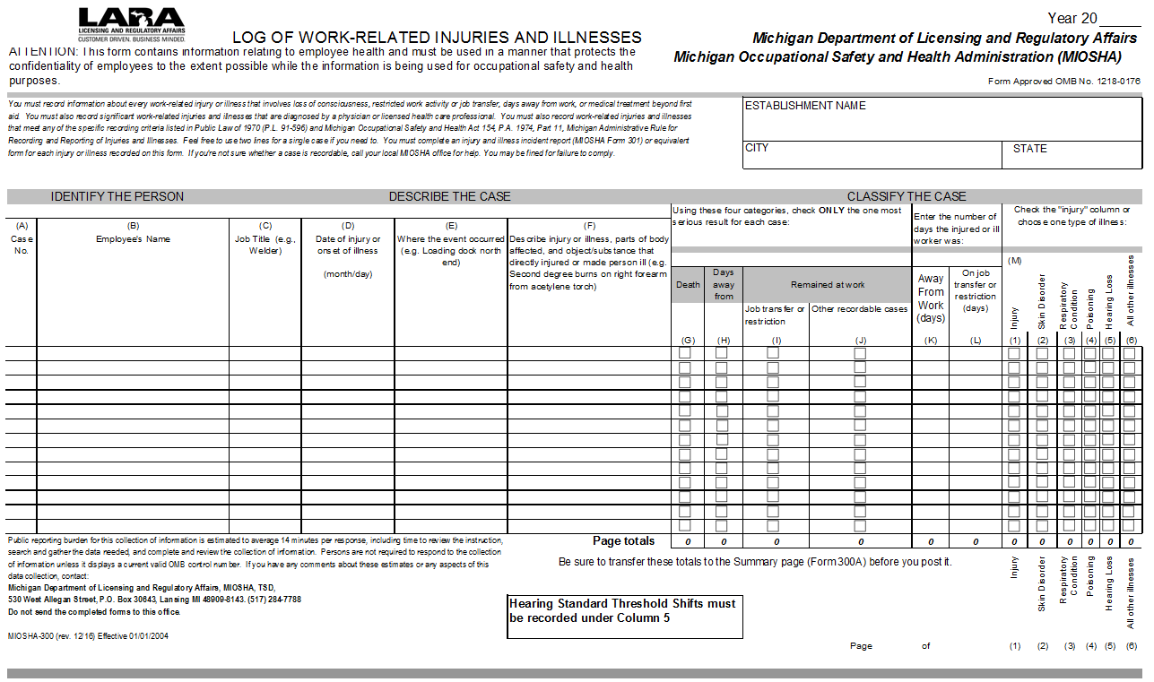
MIOSHA Log 300
Notes:
This slide and the next 2 are copies which the students should be provided with and can be referenced when talking about this slide and the next 2.
When filling out the Log 300, make sure they put all information in (F)
Page 16 of standard
Rule 1129 (2) What do I need to do to complete the MIOSHA 300 Log?
You must enter information about your business at the top of the MIOSHA 300 Log, enter a 1 or 2-line description for each recordable injury or illness, and summarize this information on the MIOSHA 300A at the end of the year.

Slide 30
Complete Section (F) fully
(C) Job Title | (D) Date of Injury | (E) Where the event occurred | (F) Describe injury or illness, parts of body affected and object/substance that directly injured or made person ill
RN | 10/21 | OR | Finger MORE INFORMATION NEEDED
EMT | 11/3 | ER | Shoulder MORE INFORMATION NEEDED
Tech | 12/8 | Diagnostic Imaging | Pinched finger between two tables
RN | 12/14 | Patient room | Aggressive patient, grabbed and bruised L. Arm
Service Tech | 12/18 | Laundry | Bend/twist: Lifting linen bag, strained R. hip and back

Slide 31
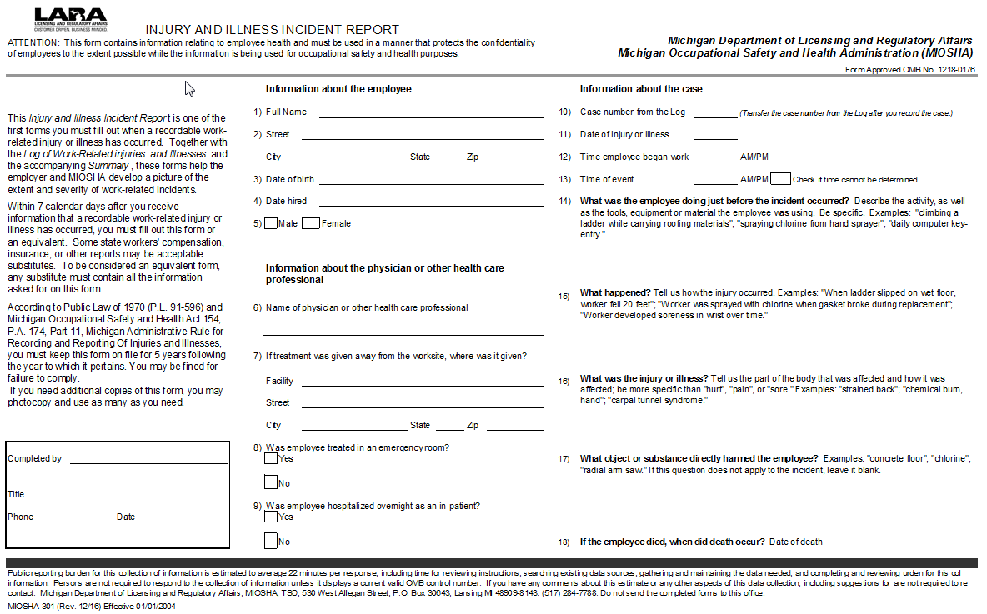
MIOSHA Log 301
MIOSHA Log 301
Notes:
Rule 1129 (3) What do I need to do to complete the MIOSHA 301 Incident Report?
You must complete a MIOSHA 301 Incident Report form, or an equivalent form, for each recordable injury or illness entered on the MIOSHA 300 Log. (5) What is an equivalent form?
An equivalent form is a form that has the same information, is as readable and understandable, and is completed using the same instructions as the MIOSHA form it replaces. Many employers use an insurance form instead of the MIOSHA 301 Incident Report, or supplement an insurance form by adding any additional information required by MIOSHA.

Slide 32
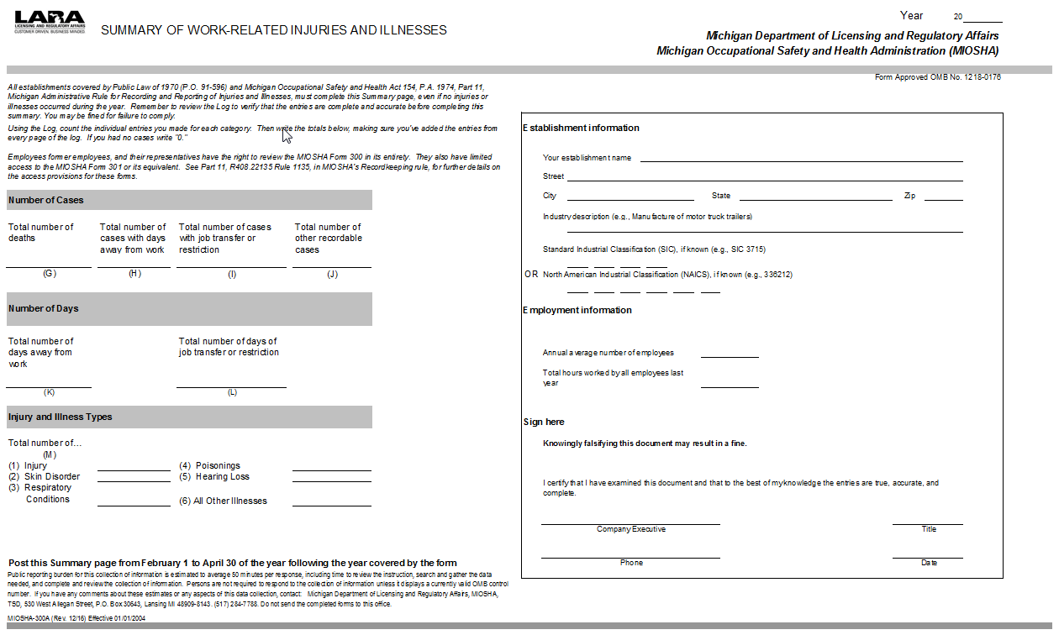
MIOSHA Log 300A

Slide 33
Forms
You must enter each recordable injury or illness on the MIOSHA 300 and 301 (or equivalent) incident report within seven calendar days.
Forms can be kept on a computer or at another location as long as they can be produced when they are requested.
Notes:
Most workers compensation forms have the same information.
Rule 1129
(4) How quickly must each injury or illness be recorded? You must enter each recordable injury or illness on the MIOSHA 300 log and 301 incident report within 7 calendar days of receiving information that a recordable injury or illness has occurred.
(5) What is an equivalent form? An equivalent form is one that has the same information, is as readable and understandable, and is completed using the same instructions as the MIOSHA form it replaces. Many employers use an insurance form instead of the MIOSHA 301 incident report, or supplement an insurance form by adding any additional information required by MIOSHA.
(6) May I keep my records on a computer? Yes, if the computer can produce equivalent forms when they are needed, as described under R 408.22135 and R 408.22140, you may keep your records using the computer system.
Ensure employees privacy, and if requested someone has access to the files if the person in charge is not available.

Slide 34
Illness Classification - Skin Diseases or Disorders:
Exposure to chemicals, plants, or other substances.
Examples: Contact dermatitis, eczema, or rash caused by primary irritants and sensitizers or poisonous plants; oil acne; friction blisters, chrome ulcers; inflammation of the skin.
Notes:
Illness classifications refers to the Log 300 Column M 2 where the employer has to choose the type of illness.
At this slide you might want to have the attendees look at the log 300

Slide 35
Illness Classification - Respiratory Conditions:
Associated with breathing hazardous biological agents, chemicals, dust, gases, vapors, or fumes
Examples: Silicosis, asbestosis, acute congestion, occupational asthma, reactive airways, toxic inhalation injury.
Note: certain disinfectants such as quaternary ammonium compounds (Quats), Phenol, etc. are asthma sensitizers.
Notes:
Illness classifications refers to the Log 300 Column M 3 where the employer chooses the type of illness.

Slide 36
Illness Classification – Poisoning:
Includes disorders evidenced by the abnormal concentration of toxic substances in bodily fluids or breath caused by absorption or ingestion
Examples: Lead, mercury, cadmium, arsenic, or other metals; carbon monoxide, hydrogen sulfide, organic solvents; insecticide sprays; poisoning by other chemicals
Notes:
Illness classifications refers to the Log 300 Column M 4 where the employer has to choose the type of illness.

Slide 37
Illness Classification - Other illnesses:
Heatstroke
Sunstroke
Heat exhaustion
Heat stress
Freezing
Frostbite
Effects of ionizing and nonionizing radiation (welding flash, ultra-violet rays, lasers)
Bloodborne pathogens
Tumors…
Notes:
Column M 6 on the log 300
Ergo and CTD’s

Slide 38
Musculoskeletal Disorders (MSDs)
Injuries and disorders of the muscles, nerves, tendons, ligaments, joints, cartilage and spinal discs.
May record as injury or all other illness.
Notes:
The reason for this slide is in the past (log 200) all repetitive motion disorders were recordable, but since 2002 the repetitive motion disorders must still meet the general recording criteria in order to be recordable.

Slide 39
Musculoskeletal Disorders
Applies the same recording criteria to musculoskeletal disorders (MSDs) as to all other injuries and illnesses.
Employer retains flexibility to determine whether an event or exposure in the work environment caused or contributed to MSD.
Notes:
Injuries and disorders of the muscles, nerves, tendons, ligaments, joints, cartilage and spinal discs.
Rule 1129. (8) (f) Other illnesses, if the employee independently and voluntarily requests that his or her name not be entered on the log. After January 1, 2003, musculoskeletal disorders (MSDs) are not considered privacy concern cases.

Slide 40
Privacy Concern Cases
An injury or illness to an intimate body part or reproductive system.
An injury or illness resulting from sexual assault.
Mental illness.
Notes:
Rule 1129 (8) How do I determine if an injury or illness is a privacy concern case? You must consider all of the
following injuries or illnesses to be privacy concern cases:
(a) An injury or illness to an intimate body part or the reproductive system.
(b) An injury or illness resulting from a sexual assault.
(c) Mental illnesses.

Slide 41
Privacy Concern Cases
HIV infection, hepatitis, tuberculosis
Needlestick and sharps injuries
If the employee independently and voluntarily requests that his or her name not be entered on the MIOSHA 300 log.
Notes:
Rule 1129(8)
(d) HIV infection, hepatitis, or tuberculosis.
(e) Needlestick injuries and cuts from sharp objects that are contaminated with another person's blood or other potentially infectious material (see R 408.22113(2) and R 408.22107(2) for definitions).
(f) Other illnesses, if the employee independently and voluntarily requests that his or her name not be entered on the log. After January 1, 2003, musculoskeletal disorders (MSDs) are not considered privacy concern cases.

Slide 42
Privacy Concern Cases
You may not enter the employee's name on the MIOSHA 300 Log.
Instead enter "privacy case" in the space normally used for the employee's name.
You must keep a separate confidential list of the case numbers and employee names for your privacy concern cases.
Notes:
Rule 1129 (7) Are there situations where I do not put the employee's name on the forms for privacy reasons? Yes. If you have a "privacy concern case” you may not enter the employee's name on the MIOSHA 300 Log. Instead enter "privacy case" in the space normally used for the employee's name. This will protect the privacy of the injured or ill employee when another employee a former employee or an authorized employee representative is provided access to the MIOSHA 300 Log under R 408.22135(3). You must keep a separate confidential list of the case numbers and employee names for your privacy concern cases so you can update the cases and provide the information to the government if asked to do so.
Rule 1129 (8) How do I determine if an injury or illness is a privacy concern case? You must consider all of the
following injuries or illnesses to be privacy concern cases:
(a) An injury or illness to an intimate body part or the reproductive system.
(b) An injury or illness resulting from a sexual assault.
(c) Mental illnesses.

Slide 43
Privacy Protection
If you believe that information describing the privacy concern case may be personally identifiable even though the employee’s name has been omitted.
You may use discretion and put “privacy case” on the MIOSHA 300 and 301 forms.
Keep a separate confidential list of the case numbers and employee names.
Notes:
Rule 1129(10) If I have removed the employee's name, but still believe that the employee may be identified from the information on the forms, is there anything else that I can do to further protect the employee's privacy?
Yes. If you have a reasonable basis to believe that information describing the privacy concern case may be personally identifiable even though the employee's name has been omitted, you may use discretion in describing the injury or illness on both the MIOSHA 300 and 301 forms. You must enter enough information to identify the cause of the incident and the general severity of the injury or illness, but you do not need to include details of an intimate or private nature. For example, a sexual assault case could be described as "injury from assault," or an injury to a reproductive organ could be described as "lower abdominal injury."

Slide 44
Privacy Protection
Other privacy protections:
If you give the forms to people not authorized by the rule, you must remove the names first.
Exceptions for:
Auditor/consultant.
Workers’ compensation or other insurance.
Public health authority or law enforcement agency.
Notes:
Rule 1129 (11) What must I do to protect employee privacy if I wish to provide access to the MIOSHA forms 300 and 301 to persons other than government representatives, employees, former employees, or authorized representatives? If you decide to voluntarily disclose the forms to persons other than government representatives, employees, former employees, or authorized representatives, as required by R 408.22135 and R 408.22140, you must remove or hide the employees' names and other personally identifying information, except for the following cases. You may disclose the forms with personally identifying information only as follows:
(a) To an auditor or consultant hired by the employer to evaluate the safety and health program.
(b) To the extent necessary for processing a claim for workers' compensation or other insurance benefits.
(c) To a public health authority or law enforcement agency for uses and disclosures for which consent, an authorization, or opportunity to agree or object is not required under the United States department of health and human services standards for privacy of individually identifiable health information, 45 C.F.R. §164.512 “Uses and disclosures for which an authorization or opportunity to agree or object is not required,” amended 2013, as adopted in R 408.22102a.

Slide 45
Temporary Employees
If you provide the day-to-day supervision for these employees, it is recorded on your log and you are responsible for the Reporting Requirements under this rule.
If the temporary or contractor’s employee is under the day-to-day supervision of the temporary service agency or contractor, the temporary service agency or contractor is responsible for recording the injury or illness.
See Injury and Illness Recordkeeping Requirements for Temporary Workers Fact Sheet
Notes:
It is not necessary for both the temporary service agency or contractor and the using employer to record the injury or illness. It is recommended that you coordinate your efforts to make sure that each injury and illness is recorded only once.
R 408.22131 Covered employees.
Rule 1131. (1) Basic requirement. You must record on the MIOSHA 300 log the recordable injuries and illnesses of all employees on your payroll, whether they are labor, executive, hourly, salary, part-time, seasonal, or migrant workers. You also must record the recordable injuries and illnesses that occur to employees who are not on your payroll if you supervise these employees on a day -to-day basis. If your business is organized as a sole proprietorship or partnership, the owner or partners are not considered employees for recordkeeping purposes.
(2) (b) If I obtain employees from a temporary help service, employee leasing service, or personnel supply service, do I have to record an injury or illness occurring to one of those employees? You must record these injuries and illnesses if you supervise these employees on a day-to-day basis.

Slide 46
Volunteers may be covered
Questions to ask:
Is there an employer-employee relationship?
How is work controlled?
Is there compensation?
Reviewed on a case-by-case basis
Notes:
Section 5 of the MIOSH Act defines an employee as a person permitted to work. MIOSHA applies when there is an employer-employee relationship. In evaluating volunteer work to determine whether an employer-employee relationship exists, MIOSHA considers how the work is controlled and whether there is compensation, a product produced or revenue generated. Control of work involves how work is scheduled, directed, supervised, and how materials and equipment are supplied. Compensation, product and revenue is evaluated to determine whether the level of compensation is more than De Minimis (i.e., a lunch or t-shirt, local fundraiser, etc.). If work is controlled and compensation, product or revenue is more than De Minimis, MIOSHA would cover the volunteer work.
Habitat for Humanity builds houses. Someone there is directing your volunteer activities. They have been cited in the past by MIOSHA.
Evaluating Volunteer (students are the same according to FOM 2013) Work for Coverage Under MIOSHA. Before the MIOSH Act can be applied, an employer-employee relationship must be established. The Main factor to consider is whether the work is “controlled” by a directing entity. The following analysis must be completed to determine whether there is an employer-employee relationship when a person is performing work as a volunteer:
1. Does the employer control the work? (i.e., can the individual performing the work schedule at their convenience or is the person told when to report and how to perform the work, is there a designated position that provides direction/oversight, is the equipment and material needed for the work provided for the volunteer, etc.) If the work is not controlled, there is no employer-employee relationship and the volunteer work is not covered by MIOSHA jurisdiction. The SO/IH does not need to further analyze the relationship.
2. When it is determined the work is controlled:
Check to see whether the volunteer receives any type of compensation, or whether a product is produced or revenue is generated as a result of the volunteer work. If the response is “no,” there is no employer-employee relationship and the volunteer work is not covered by MIOSHA jurisdiction. The SO/IH does not need to further analyze the relationship.
3. When there is compensation, a product produced, or revenue generated:
Determine the level of compensation, product produced or revenue generated. If the level of compensation is De Minimis (i.e., a lunch or t-shirt, local fundraiser, etc.), there is no employer-employee relationship and the volunteer work is not covered by MIOSHA jurisdiction. The SO/IH does not need to further analyze the relationship.
4. When compensation, product produced, or revenue generated is more than De Minimis:
This indicates that for MIOSHA purposes, an employer-employee relationship exists and the volunteer work performed is covered by MIOSHA safety and health standards.

Slide 47
Employee Involvement
Requires employers to establish a procedure for employees to report injuries and illnesses and how to make the report.
Employees have the right to report a work-related injury or illness.
Employers are prohibited from discharging or in any manner discriminating against employees for reporting work-related injuries or illnesses.
Notes:
Rule 1135. (1) Basic requirement. Your employees and their representatives must be involved in the recordkeeping system as follows:
(a) You must inform each employee of how he or she is to report a work-related injury or illness to you.
(b) You must provide employees with the information described in sub rule (2)(c) of this rule.
(c) You must provide access to your injury and illness records for your employees and their representatives.
(2) Implementation. What must I do to make sure that employees report work-related injuries and illnesses to me?
(a) You must establish a reasonable procedure for employees to report work-related injuries and illnesses promptly and accurately. A procedure is not reasonable if it would deter or discourage a reasonable employee from accurately reporting a workplace injury or illness.
(b) You must inform each employee of your procedure for reporting work-related injuries and illnesses.
(c) You must inform each employee of both of the following:
(i) Employees have the right to report work-related injuries and illnesses.
(ii) Employers are prohibited from discharging or in any manner discriminating against employees for reporting work-related injuries or illnesses.
(d) You must not discharge or in any manner discriminate against any employee for reporting a work-related injury or illness.

Slide 48
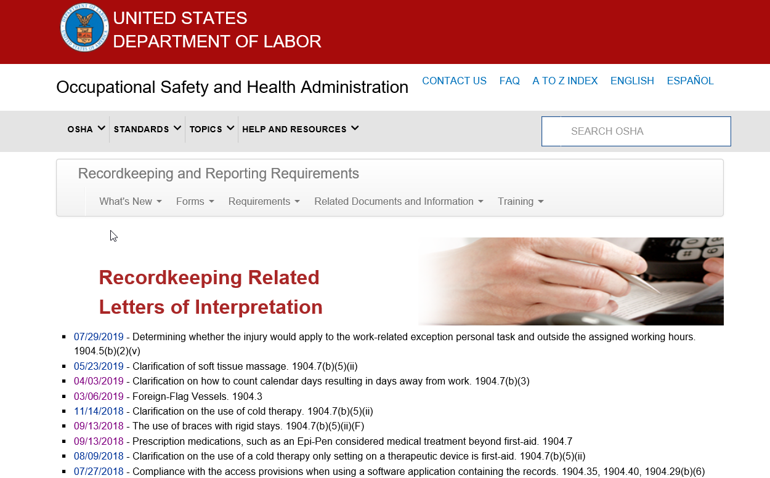
OSHA Website Information https://www.osha.gov/recordkeeping/RKinterpretations.html
Notes:
Employee Involvement link will have scenario’s for the discrimination questions.

Slide 49
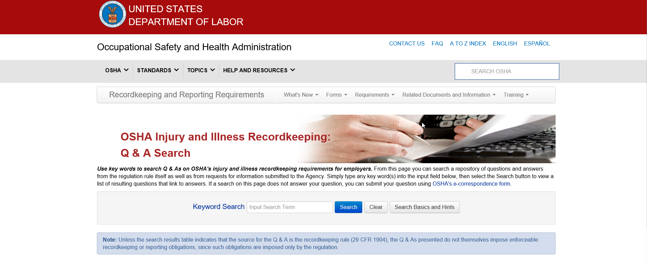
OSHA Website Information https://www.osha.gov/recordkeeping/faq_search/index.html

Slide 50
Occupational Disease Reporting
Occupational Disease Definition: Human illness from employment with one of the following:
Repeated or continuous exposure.
Acute exposure to hazardous substance.
Presentation symptoms of a disease known to be associated with specific exposure.
Notes:
Refer to the “Occupational Disease Reporting” handout found on the student’s flash drive.

Slide 51
Occupational Disease Reporting Form MTSD-51
Form 300, entries in column M(2-6) are required to be reported.
Who must report:
Physician, Hospital, Clinic or Employer
When:
Within ten days after discovery of the occupational disease or condition.

Slide 52
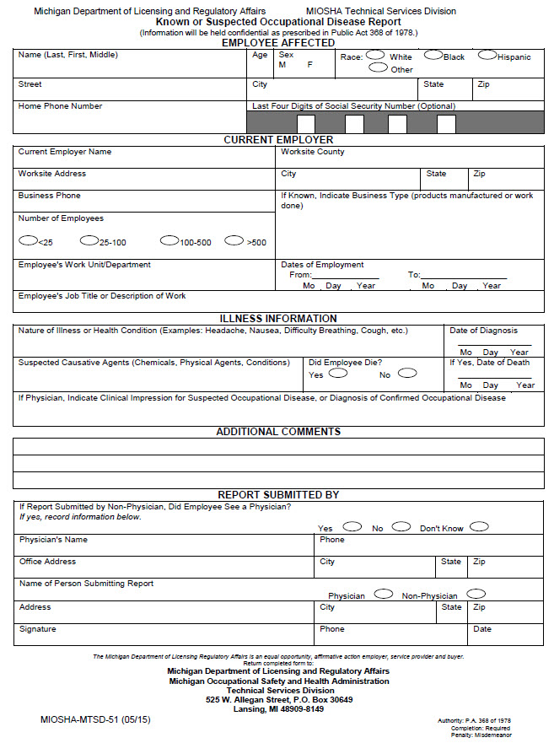

Slide 53
Expanded Reporting Requirements
The rule expands the list of severe work-related injuries and illnesses that all employers must report to MIOSHA as described below.
Fatalities within eight hours
And the following within 24 hours:
In-patient hospitalizations of one or more employees
Amputations
Loss of an eye
Notes:
Most of the participants have heard of the new Federal changes as of January 1, 2015. this slide and the next 4 are the changes.
Part 11 has been changed, still waiting for ACT 154. MIOSHA will start enforcing September 1, 2015
All employers must report
all work related fatalities to OSHA within 8 hours:
All work related in patient hospitalizations to OSHA within 24 hours (previous requirements were to report only 3 inpatient hospitalizations)
All work related amputations to OSHA within 24 hours
All related losses of any eye to OSHA within 24 hours
Please note:
In-patient hospitalization is defined as a formal admission to the in-patient service of a hospital or clinic for care or treatment.
Only fatalities occurring within 30 days of the work-related incident must be reported.
Only in-patient hospitalizations, amputations, or losses of an eye occurring within 24 hours of the work-related incident must be reported.
Employers do not have to report an event if:
It resulted from a motor vehicle accident on a public street or highway, except in a construction work zone (employers must report the event if it happened in a construction work zone).
It occurred on a commercial or public transportation system (e.g. airplane, subway, bus, ferry, street car, light rail, train).
It occurred more than 30 days after the work-related fatality or more than 24 hours after the work-related in-patient hospitalization, amputation, or loss of an eye. LOSS OF AN EYE IS LOSS OF EYE BALL OUT OF SOCKET
If the in-patient hospitalization was for diagnostic testing or observation only.
We will not respond to every report with an on-site inspection. We expect to address many of the reports through other types of investigations, but we will engage with employers whose workers have been hurt. We are developing the process to determine which incidents to inspect and which to handle using other types of investigations and interventions.

Slide 54
What is an Incident Rate?
An OSHA Incidence Rate (IR) represents the number of recordable injuries and illnesses that occur among a given number of full-time workers (usually based on 100) over a given period of time (typically one calendar year).
For example, a calculated rate of 5.0 for a contractor represents a rate of injury and/or illness at five per 100 workers. It does not matter if the contractor employs 20 or 2,000 workers, the rate will always be based on 100 workers, allowing one to compare rates for various contractors of different size.

Slide 55
How An Incident Rate Is Calculated
Total Rec. Cases x 200,000
Total Hours Worked
The 200,000 figure in the formula represents the number of hours 100 employees working 40 hours per week, 50 weeks per year would work and provides the standard base for calculating incidence rates.

Slide 56
Employer Days Away Restricted Transfer Rate (DART) Calculation
Cases with Lost, Restricted, Transfer Days x 200,000
Total Hours Worked

Slide 57
TCIR and DART Rates for 622
2017
2018
MI TCIR = 5.7
National=5.7
MI DART = 2.1
National = 2.2
MI TCIR = 7.0
National = 5.6
MI DART = 3.0
National = 2.2

Slide 58
Compare Your Company to Others
In Michigan :
http://www.michigan.gov/lara/0,4601,7-154-11407_30929-39936--,00.html
In the Nation:
https://www.bls.gov/iif/oshsum.htm

Slide 59
Three Things That Are Extremely Important To Remember
Read and refer to Part 11. Recording and Reporting of Occupational Injuries and Illnesses standard.
Documentation is essential.
When in doubt, record.

Slide 60
Recordkeeping Questions?
General Assistance / Forms / Posters / Information
Michigan Occupational Safety and Health Administration (MIOSHA) Technical Services Division (TSD) Management Information Systems Section (MISS) 530 W. Allegan Street, P.O. Box 30643 Lansing, Michigan 48909-8143
www.michigan.gov/recordkeeping 517-284-7788
Notes:
Conduct Recordkeeping Exercises if time permits.

Slide 61
From the emails you sent us:

Slide 62
All blood borne pathogen exposures- whether needle stick or splash get reported [recordable], right?
For 300 Log: Contaminated needlesticks always (Privacy case). Uncontaminated needlesticks only get recorded if they are beyond first aid. Splash exposures are recorded only if treatment goes beyond 1st aid, prescription issued or disease results.
For BID: Needlesticks on separate sharps injury log; no requirement to record splashes but may be prudent to document if caused by a “safer” medical device so this can be reviewed during the required annual device assessment/evaluation.

Slide 63
If an employee is involved in an exposure and receives medication as part of the prevention but never has any symptoms of disease (so no injury) are they an OSHA case? I have always been told no if the medication was for prevention. Another employee health nurse called and was told that it is an OSHA case. Can you please review and provide supporting data for the correct answer?
ANY prescription medication, unless included in the First Aid exemption (i.e. tetanus immunization), is recordable. See letter of interpretation:
https://www.osha.gov/laws-regs/standardinterpretations/2014-10-20-0

Slide 64
If a person falls in a public street, for example crossing the road after parking their car in a lot owned by their company, and they are injured is it an OSHA case? I have been told to remove one from the OSHA log but for another case when I called, I was told to put it on the OSHA log. Can you provide the answer with supporting data?
“No, this injury is not work-related. A parking area where the employer does not have control (such as a parking lot outside of a building shared by different employers, or a public parking area like those found at a mall or beneath a multi-employer office building) would not be considered part of the employer's establishment, and therefore not part of the work environment.”
https://www.osha.gov/recordkeeping/faq_search/index.html
Text above was copied from FAQ page by searching “parking lot.”

Slide 65
Please note:
Recordable ≠ Compensable
Some injuries may be covered by worker’s comp but are not recordable.
Example: slip and fall in employer’s parking lot while commuting to work.

Slide 66
You have an OSHA incident that occurred in late December and you estimate on the OSHA log how many days you anticipate the employee to be off work. Besides updating the OSHA log in your facilities records, should an update be sent to MIOSHA or to where we submit our BLS or OSHA ITA reporting? Can you discuss the 180-day rule please?
There is no need to send an update MIOSHA or OSHA. The days estimated days away must be included on the log where the injury occurred. So, if an injury happened on 12/31/2019 and LHCP said they would be off 6 months, 180 days is recorded on the 2019 log. The 180-day rule is simply the cut off where an employer is able to stop recording that particular injury.

Slide 67
If the employee is put on restrictions of any kind- is it reportable?
There is no requirement to report a restriction to MIOSHA/OSHA; however you may have to record restrictions on the 300 Log…
If the restriction is from a work-related injury, then it is recordable regardless if the restriction comes from the employer or the LHCP. This is recordable if the restrictions prevent then from doing any part of their normal job that they would do over a 7-day period.
It is NOT recordable if the restriction is from something not related to work (i.e. injury at home or personal medical condition).
Notes:
From Deb Z - Restriction are never reportable, but are recordable if the restrictions prevent them from doing any part of their normal job that they would do in a 7 day period. Once those restrictions prevent them from doing their normal job - it goes on the log.
1112(2) How do I decide if the injury or illness resulted in restricted work? Restricted work occurs when, as the result of a work-related injury or illness, either of the following occurs: (a) You keep the employee from performing 1 or more of the routine functions of his or her job, or from working the full workday that he or she would otherwise have been scheduled to work. (b) A physician or other licensed health care professional recommends that the employee not perform 1 or more of the routine functions of his or her job, or not work the full workday that he or she would otherwise have been scheduled to work. (3) What is meant by "routine functions"?

Slide 68
If an RX is prescribed for a work injury but the employee does not fill the RX is this still recordable?
Yes, the prescription is the trigger. A LHCP prescribed it so it is recordable.
Notes:
1112d(6) What if a physician or other licensed health care professional recommends medical treatment but the employee does not follow the recommendation? If a physician or other licensed health care professional recommends medical treatment, you should encourage the injured or ill employee to follow that recommendation. However, you must record the case even if the injured or ill employee does not follow the physician or other licensed health care professional's recommendation.

Slide 69
Is a TD vaccination given for a hand cut recordable?
We give vaccinations upon request in Employee Health.
Tetanus immunizations are considered First Aid and do NOT need to be recorded. If the hand cut required treatment beyond first aid or the employee was transferred or given restrictions based on the cut, then it would need to be recorded.
Please note this is not the case for other vaccines like HBV when given for post-exposure treatment.

Slide 71
I have had mixed answers on this, when an employee is exposed to Hep A, we will give hep A vaccine as a prophylactic, is this considered more than the first aid and needs to be added to the OSHA log or only if the employee actually gets Hep A from the exposure?
When given in response to a BID exposure, any booster or vaccine is considered to be recordable. If given ONLY as a preventative against possible FUTURE exposures, it is NOT recordable since the employee did not experience an injury or a BID exposure. See letter of interp:
https://www.osha.gov/laws-regs/standardinterpretations/1999-08-04

Slide 72
Is a work injury recordable if the employee needs to wear a soft splint while at work? No restrictions are listed, but the employee is assigned different job duties within their home department.
The soft splint isn’t the trigger here. Soft splints fall under first aid. It is the fact that the employer assigned them different duties presumably from the injury. An employer-imposed restriction/transfer is the same as a LHCP restriction/transfer.

Slide 73
What do you do when an ED bill has been generated, documenting a work injury (billing department calls Employee Health looking for a claim number) but employee refuses to report?
The employee reported it to the ED as a work-related injury so it should be recordable regardless of whether or not it went through the proper channels.

Slide 74
Do I need to contact MIOSHA when a reported hospitalization stay was deemed non work related when initially it was thought to be work related and reported as such?
The work relatedness is presumed. I would anticipate it was found to be NON work related sometime AFTER the 24-hour requirement. Without more information on this, I would state that it needed to be reported if it met all the criteria.

Slide 75
When we have an employee who is injured and later, say 2 months after injury, now requires surgery, do we have to call MIOSHA and report this? Or only when the employee goes to surgery immediately after injury.
No, only when the hospitalization occurs within 24 hours of the injury. Rule 1139(9).

Slide 76
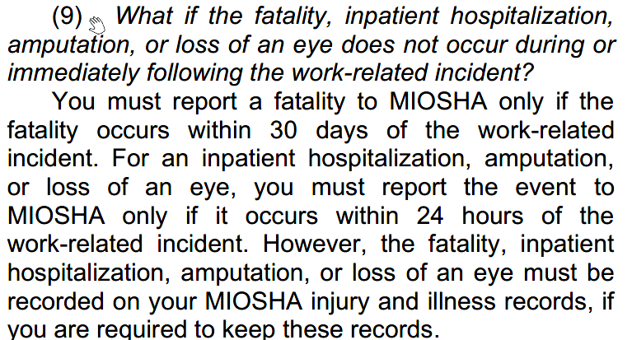

Slide 77
How many OHSA 300A logs need to be submitted when you have different subgroups/companies within your hospital?
A firm with more than one establishment may submit establishment-specific data for multiple establishments. To do this, the firm will create one registration and follow the directions provided to submit data for multiple establishments. It is important to note that the electronic reporting requirements are for data at the establishment level, not the firm level. The submitted data must be specific for each individual establishment.
https://www.osha.gov/recordkeeping/faq_search/index.html

Slide 78
What is the actual due date for submission? I see on the form it states that it needs to be posted from Feb 1 through April 30. A coworker told me this is due Feb 28. Someone I spoke to from the Bureau of Labor Statistics told me March 2. I would appreciate clarification.
March 2 is the deadline for submission to Federal OSHA. The February 1 to April 30th dates are the required timeframe for posting your 300 A Summary in the workplace.

Slide 79
Thank You For Attending This Presentation
Michigan Department of Labor and Economic Opportunity
Michigan Occupational Safety and Health Administration
Consultation Education and Training Division
P.O. Box 30643
525 West Allegan Street
Lansing, MI 48909-8143
Phone: 517-284-7720
Fax: 517-284-7725
www.michigan.gov/miosha

