Slide 1
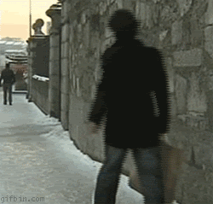
Slip, Trip and Fall Prevention
Winter Weather Strategies
Teresa (Terry) Fisk, MS, CIH, CSP, CIE, CHSP
Industrial Hygienist
teresafisk907@gmail.com
MaryAnn L. Northcote, CPP, CHSP
Safety and Workers’ Compensation Manager, McLaren Health Care
MaryAnn.Northcote@McLaren.org

Slide 2

Slip Trip Optimum Protection
During this discussion, we will:
Review Components of a comprehensive Slip, Trip and Fall (STF) Prevention program
Discuss Statistics and facts about slips and falls to emphasis the importance of this healthcare problem particularly during the winter weather months and how to use your own statistics.
Discuss the importance of prompt reporting and response.
Communicate ways and strategies to improve walking and situational awareness.
Identify standardized equipment and processes: snow and ice removal and management, walk off mats, monitoring and clean up, and use of appropriate footwear
Review techniques and strategies for minimizing the damage caused by same level falls

Slide 3
Components of a Comprehensive Slip, Trip and Fall (STF) Prevention Program
Note: STF Prevention is a component of a broader comprehensive safety program. Winter weather is a component of the STF Prevention program and creates opportunities for learning and improving such as responding to rapidly changing conditions; improving situational awareness; providing safe transport to and from remote parking areas and use of appropriate footwear.
Hazard Assessments and Inspections
Event Reporting and Causal analysis
Loss and data trending
Awareness and Promotional Campaigns
Progressive Education and Training
Identification of Standardized Equipment and Processes: Maintenance, Cleaning, Footwear
Accountability and Feedback at Every Level
Notes:
NIOSH Total Worker Health- Policies, programs, and practices that integrate protection from work-related safety & health hazards with promotion of injury and illness prevention efforts to advance worker well-being.

Slide 4
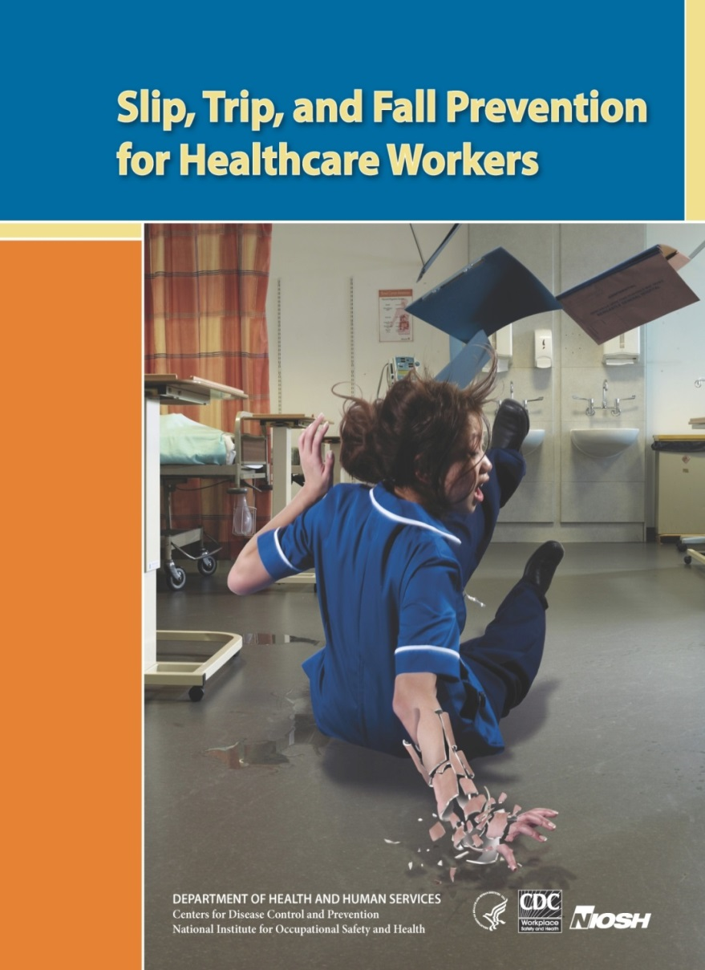
National Healthcare Slip, Trip, and Fall Injury Statistics
For all industries slips and falls are escalating. Healthcare is one of the key market segments most affected by slip, trip and fall injuries.
Healthcare STF Injuries
The second highest source of injury based on days away from work
The incident rate of lost workday cases from same level, slip, trip and fall (STF) injuries in healthcare are approximately 78% higher than all other private industries combined.
Profile (Who slips and falls in healthcare?): Female, >45yrs. of age and job tenure < 6 months.
Historical research around risk factors and prevention has been weak.
NIOSH Total Worker Health
Notes:
NIOSH Total Worker Health- Policies, programs, and practices that integrate protection from work-related safety & health hazards with promotion of injury and illness prevention efforts to advance worker well-being.

Slide 5
Causes of Injury and Illness in Education and Health Services – By Event or Exposure
Bureau of Labor Statistics: 2016 Nonfatal injuries and illnesses involving days away from work - Education and Health Services
Notes:
National data: Total number of nonfatal injuries and illnesses (Days Away) 2016 by EVENT OR EXPOSURE:
Education and Health Services – Total – 166,530
Violence and other injuries by persons or animals = 22,190
Intentional by person = 12,750 (11,810 hitting, kicking, beating, shoving)
Unintentional by person = 8,080 (4,040 occurred while restraining/subduing or while moving)
Transportation incidents = 7,810
Falls, Slips, Trips = 43,660
Exposure to harmful substances or environments = 6,100
Contact with objects and equipment = 21,110
Overexertion and bodily reaction = 65,160
Other = 490
Nonfatal of injury or illness by SOURCE
Education and Health Services = 166,530
Chemicals and chemical products = 2100
Containers, furniture and fixtures = 16,640 (Containers = boxes, crates, cartons, pots, pans, trays, cans; Furniture = beds and chairs)
Machinery = 3020 (0ver 1/3 incidents from heating, cooling and cleaning machinery also includes are Food/beverage and medical surgical and x-ray machinery)
Parts and materials = 2,280 (building materials include solid building materials, fasteners, wire)
Persons, plants, animals, and minerals = 80,650 (21,310 source is the injured or ill worker; 56,040 other than injured or ill worker of those 56,040 there were 43,520 listed as “patients” and 8,090 listed as “other client or customer”)
Structures and surfaces = 37,420 (33,340 = floors, walkways, ground surfaces)
Tools, instruments, and equipment = 9,870 (6180 medical and surgical instruments and equipment)
Vehicles = 11,170 (8020 highway vehicles; 2430 nonpowered plant and industrial vehicles like carts and dolly, hand truck)
Other sources = 2600

Slide 6
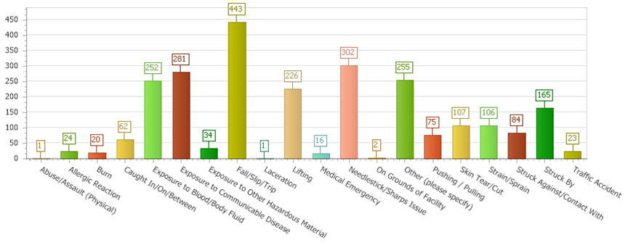
McLaren Employee Incidents by Specific Event Type Event Date: Fiscal 2016/17
Grand Total: 2348

Slide 7
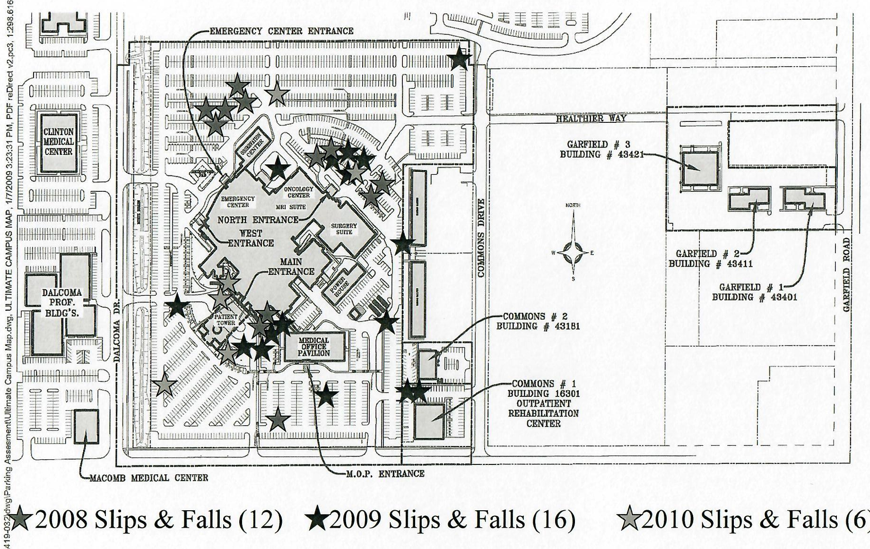
Injury Trending - Use of Slip & Fall Mapping
How do you use your data, communicate it and what does success look like?

Slide 8
SEVERITY
Loss Triangle
Sentinel Events
Safety & WC Indicators
WC Claims Data
Employee Injury/Illness Data
Near Miss Reporting
Environmental Tours
Risk Assessments
FREQUENCY

Slide 9
Employee Event Reporting and Response
Prompt Reporting- What level and what does prompt mean?
  Reporting form and process-Who initially gets this information, what information is reported and how quickly?
  Other reporting options-Verbal through the front desk or security and use of 1-800 #
Causal Analysis/Accident Investigation- Who completes these and how quickly? Is a SWARM conducted? How is the information communicated?
How are identified actionable measures corrected and documented?
Notes:
NIOSH Total Worker Health- Policies, programs, and practices that integrate protection from work-related safety & health hazards with promotion of injury and illness prevention efforts to advance worker well-being.

Slide 10

Improving Situational Awareness and Promotion Campaigns
Use of notification systems for ice and snow alerts
Use of signage in high-traffic and problem areas to notify of icy conditions
Use of internal monitors, newsletters and posters to communicate winter weather hazards, reporting procedures, minimizing distractions, and what individuals can do to walk safely to and from buildings and parking areas.
Use of Campaigns such as McLaren’s “Walk Like a Duck”
Ice Alert
Notes:
NIOSH Total Worker Health- Policies, programs, and practices that integrate protection from work-related safety & health hazards with promotion of injury and illness prevention efforts to advance worker well-being.

Slide 11

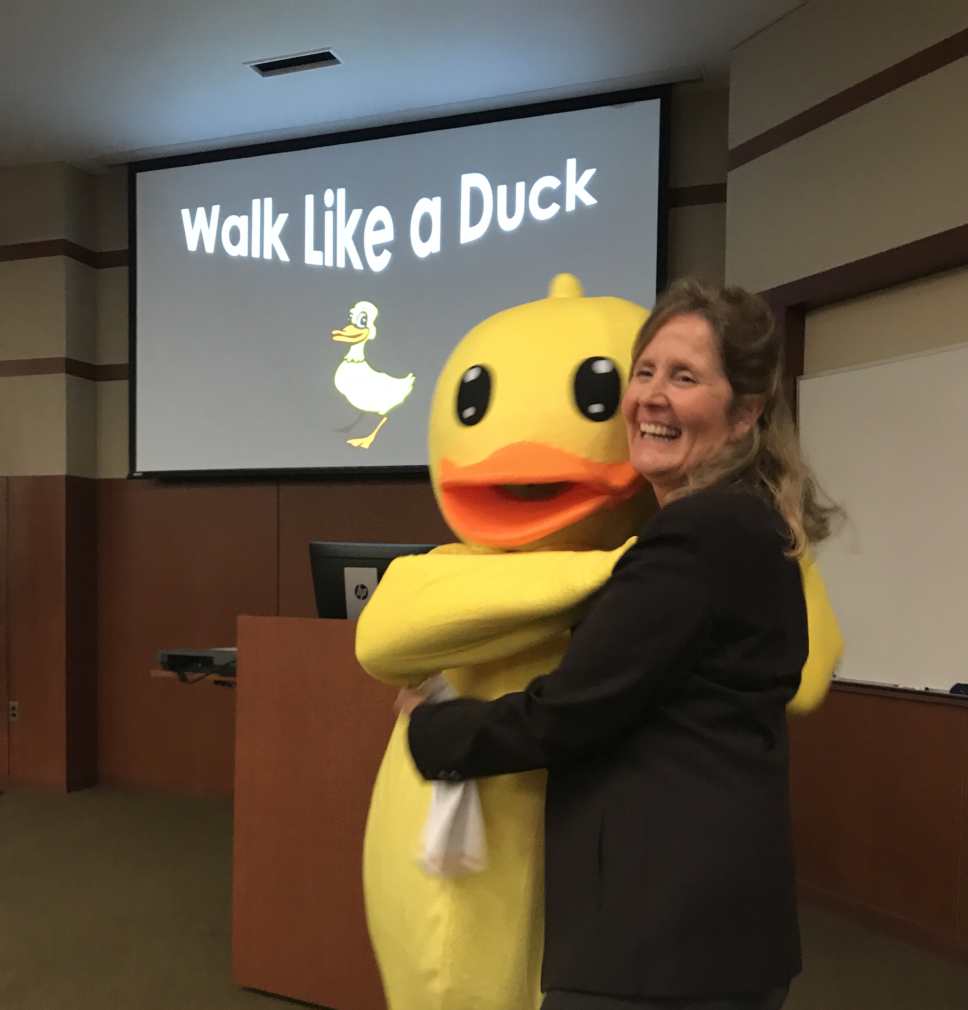
Walk Like a Duck
Slip, Trip & Fall Prevention Tool Kit
Slip, Trip & Fall Prevention Calendar
Buttons
Rubber Ducks

Slide 12
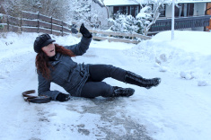
STF Prevention-Winter Weather
Be aware of current and emerging ice and snow conditions.
Use designated walkways and don’t take short cuts.
Keep hands free whenever possible.
When snow and ice is observed- Test surface. Take slow short steps
Walk like a duck.
Wear proper footwear and make sure to wipe your boots or shoes off thoroughly upon entering the hospital.
Support rapid response: Report hazards and all slip and fall accidents to the Security desk and complete an electronic incident report.

Slide 13
STF Prevention - Equipment and Processes
Snow and Ice Removal and Management- Clearly defined responsibilities, Contracts
Note: Is a debrief conducted at the end of the season?
Sand and “Salt” Containers strategically located for hard to reach areas (locations: small containers at the front desk, larger containers located at the main entrances or strategically place close to problem areas)
Run off mats are adequate, inspected and regularly cleaned for the traffic and conditions presented by the winter months
Monitoring, clean up and signage for the accumulation of water
Home Health Nurses – Higher STF hazards created by little to no control over the environment.

Slide 14
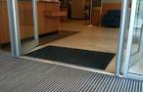
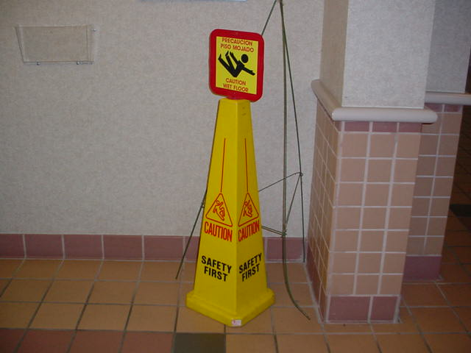
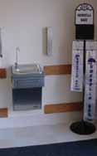
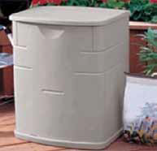
STF Prevention - Equipment and Processes

Slide 15
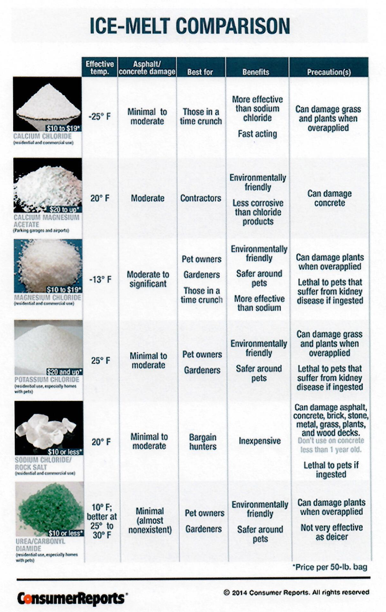

Slide 16
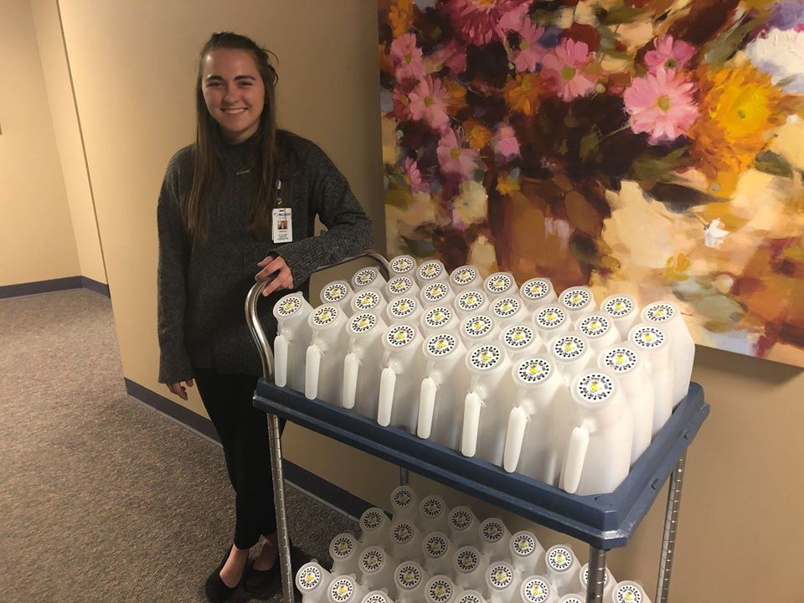
Home Healthcare- Creative Solutions
Notes:
NIOSH Total Worker Health- Policies, programs, and practices that integrate protection from work-related safety & health hazards with promotion of injury and illness prevention efforts to advance worker well-being.

Slide 17
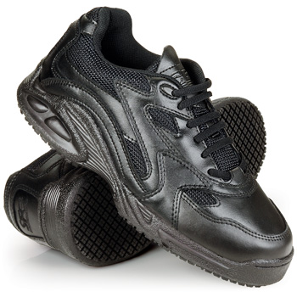
What is Safe Footwear?
A properly fitted shoe that does not cause pain or discomfort.
Shoes that are fully enclose (cradle) the foot
    No Backless or mule-type shoes
Slip resistant outsole with a coefficient of friction of 0.50 or higher
Heals-No higher than two inches and one square inch of surface area at base of heal.
Snow and ice can get caught up in the outsole tread and special care is needed particularly at entrances to buildings. Snow and ice need to be cleaned off the shoe outsole using walk off mats or other means.
Yaktrax or other types outside traction devices might also be a consideration

Slide 18
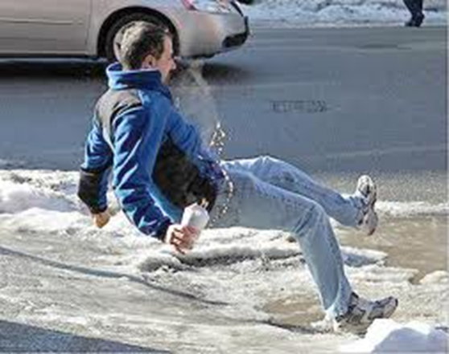
OOOO….. Fudge-When all else fails and you are falling
Butt-Roll- Relax as much as possible and do the butt roll [This spreads the force over the larger muscles.]
Spotting the Fall-When falling backwards, turn your head. The rest of the body will follow.
Shout-This reduces your internally compression and reduces the impact of the injury.
Slap the Floor-This will spread the force across the arm.
Toss the Load
Notes:
You have a second to respond and it may be the difference between being embarrassed and a serious injury.

